Slide 1
Hierarchical methods for N-Body Simulations: The Barnes-Hut Method and the Fast Multipole Method
Zhan Keith Tay

Slide 2
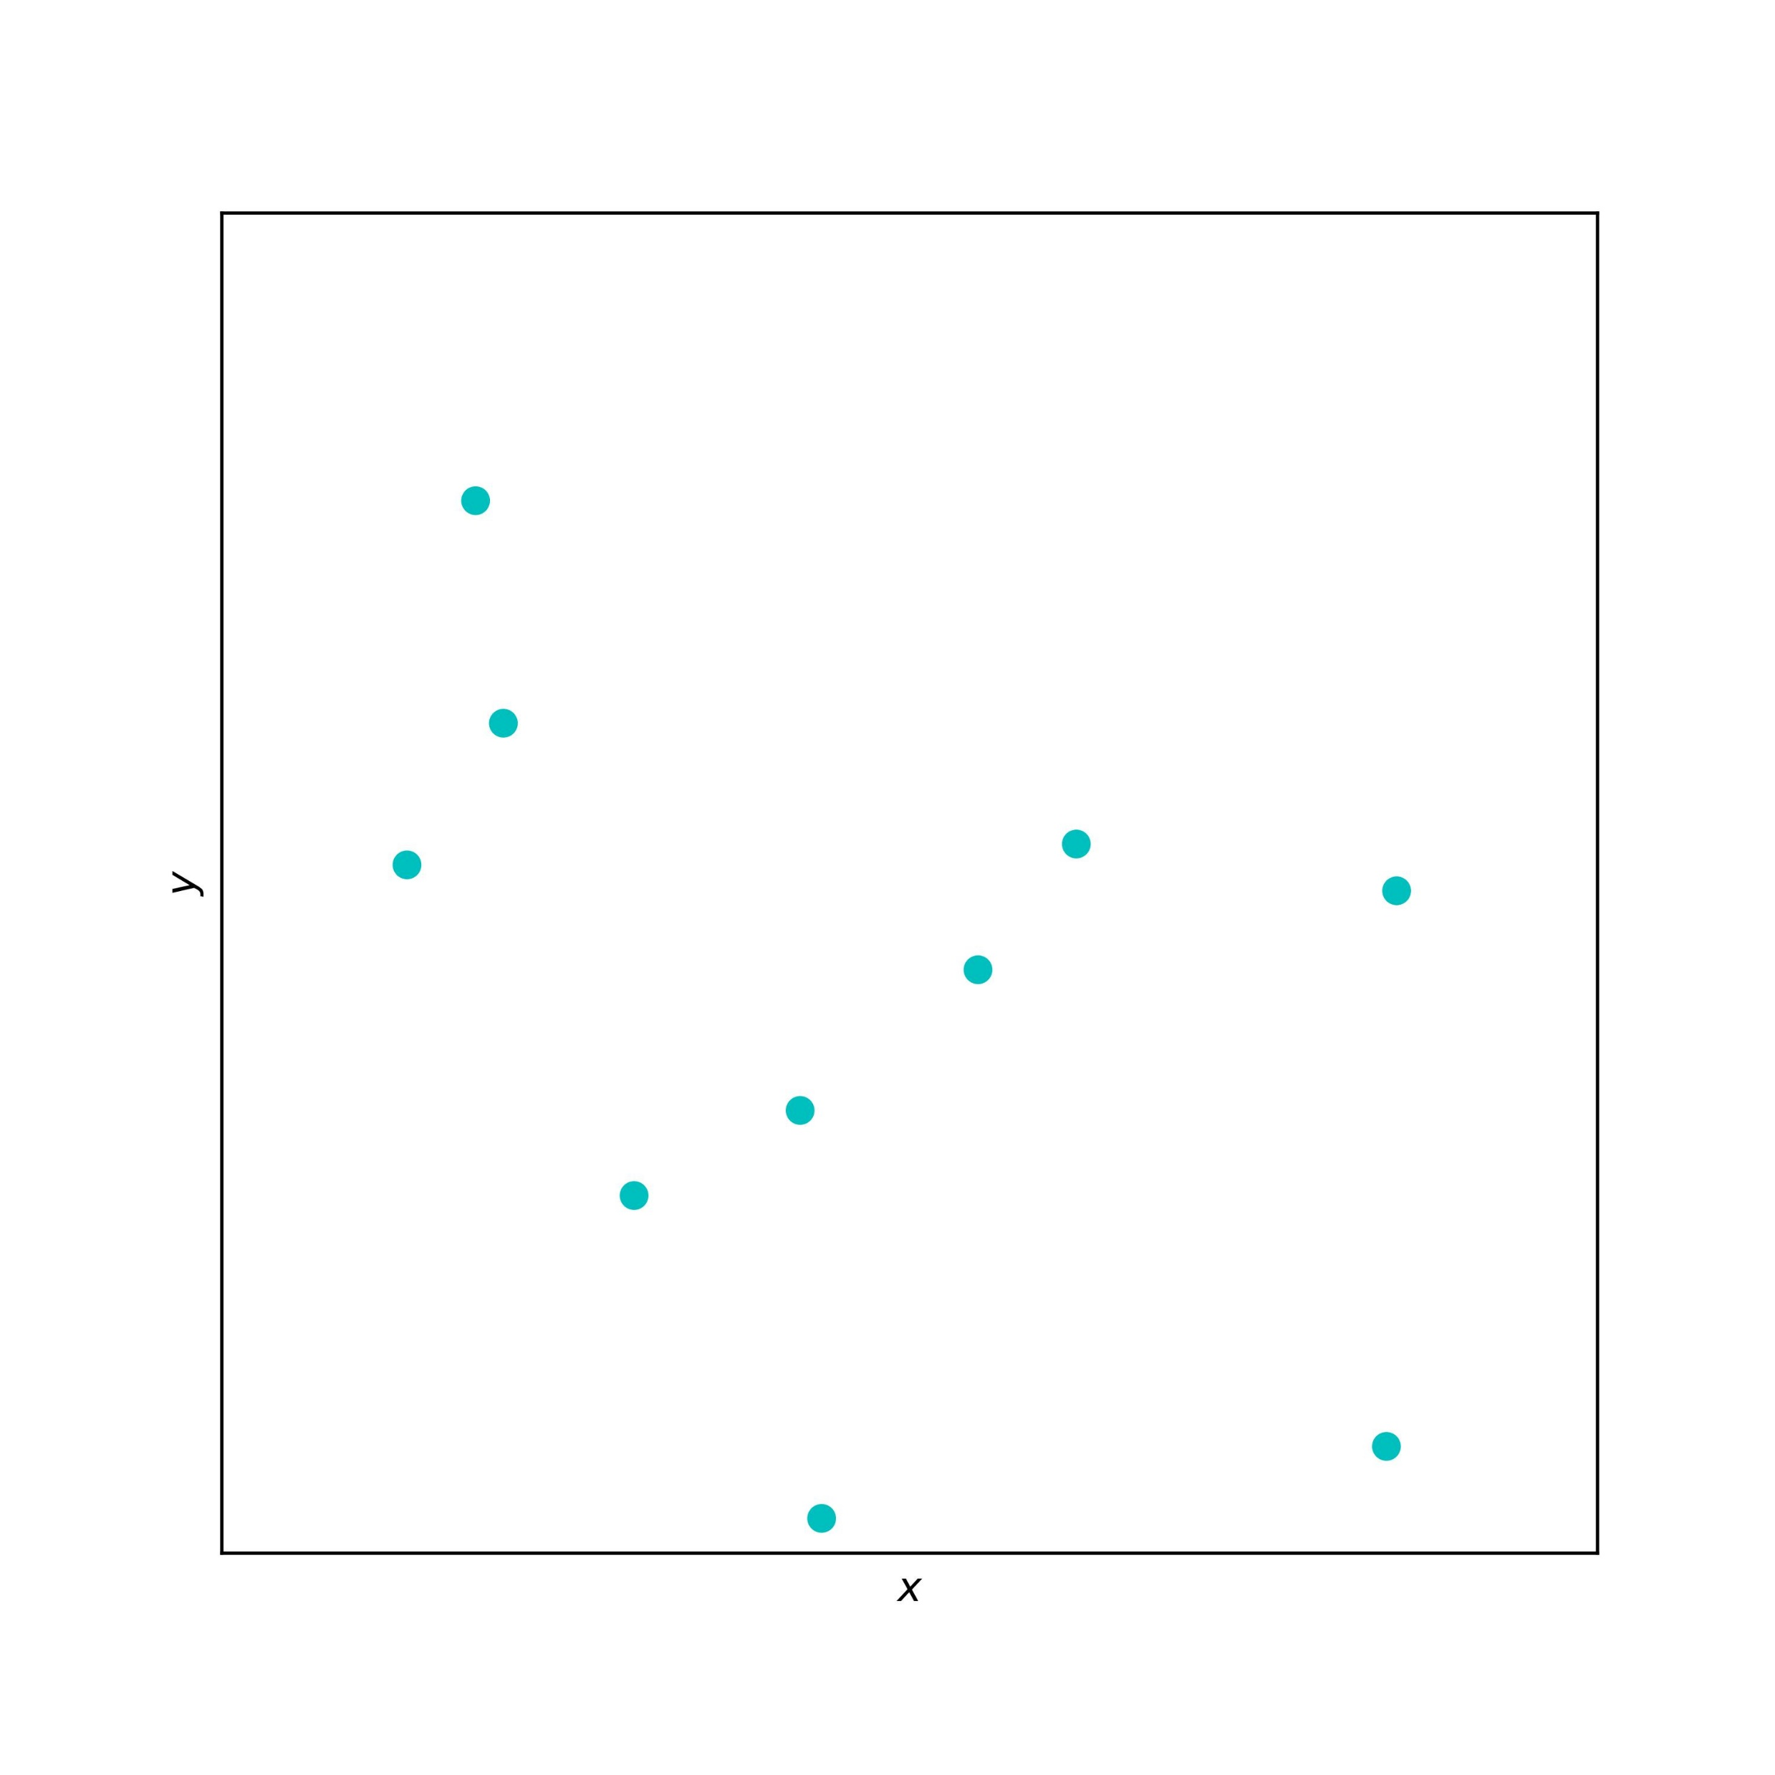
Task:
Calculate the potential/force experienced by each of the N particles in the presence of the other N - 1 particles.
E.g. N = 10

Slide 3
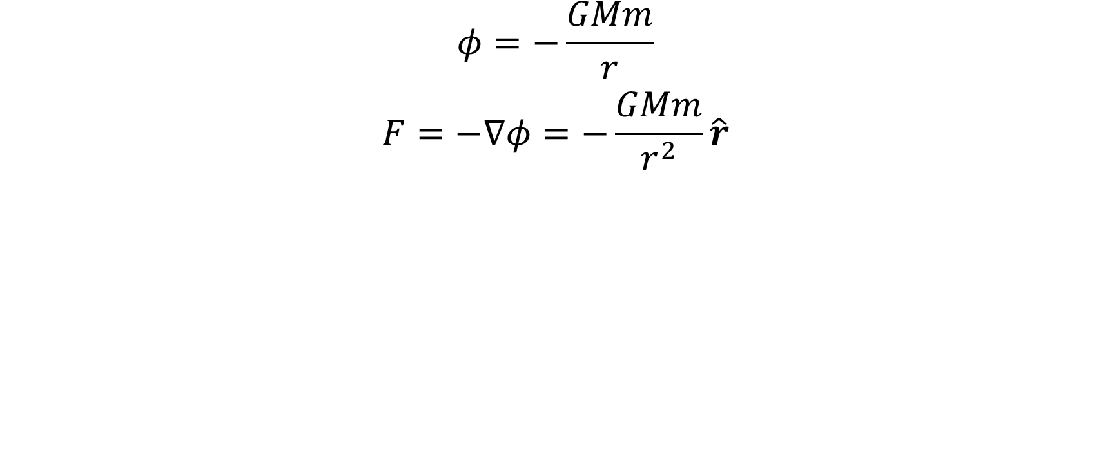
E.g. Gravitational Potential (3D)
$$\begin{matrix}φ=−\frac{GMm}{r} \\ F=−∇φ=−\frac{GMm}{r^{2}}\hat{r}\end{matrix}$$

Slide 4

Direct summation/Brute force
Consider each of the N particles in turn as a target, add up the contribution from each of the other N-1 sources.
target
sources

Slide 5
Direct summation/Brute force
Consider each of the N particles in turn as a target, add up the contribution from each of the other N-1 sources.
target
Problem
sources
Calculating the pair-wise potentials/forces for N bodies require O (N ²) operations via direct summation (i.e. a brute force calculation).

Slide 6
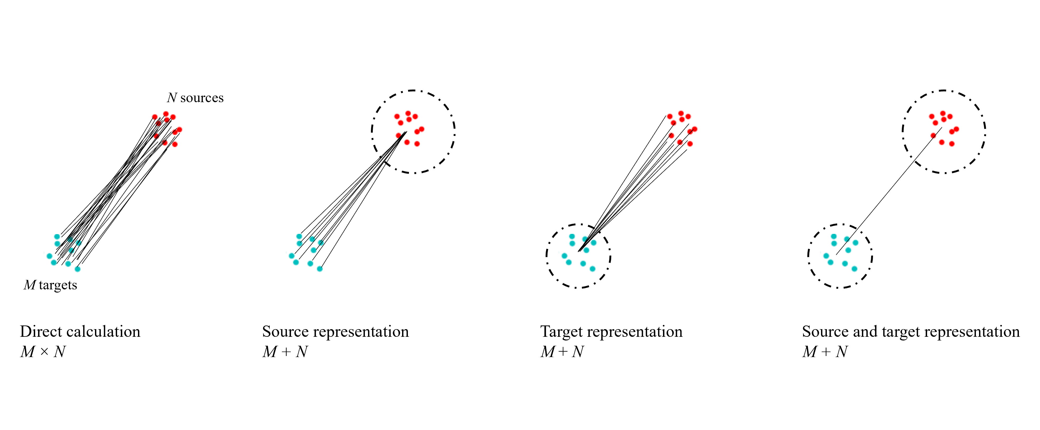
Solution
Hierarchical methods
Barnes-Hut ^{[1], [3]}
O (N logN )
Fast-Multipole Method (FMM) ^{[2], [4]}
O (N )
Both ideas are based on the fact that the pair-wise interaction strength decay as the distance between the pair increases,
hence faraway groups of particles can be treated together

Slide 7
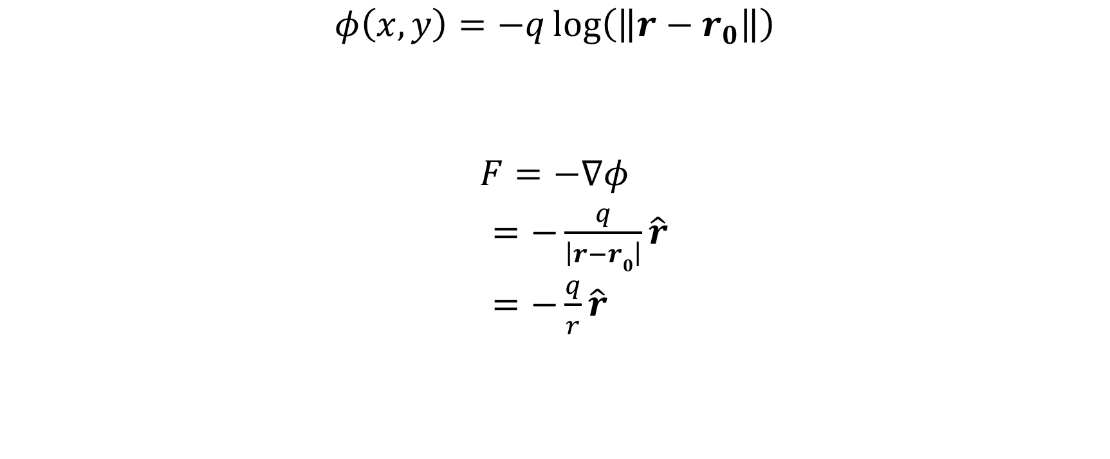
The potential (2D)
$$φ\left(x,y\right)=−q\log\left(\left\|r−r_{0}\right\|\right)$$
$$F=−∇φ$$
$=−\frac{q}{\left|r−r0\right|}\hat{r}$
$=−\frac{q}{r}\hat{r}$

Slide 8
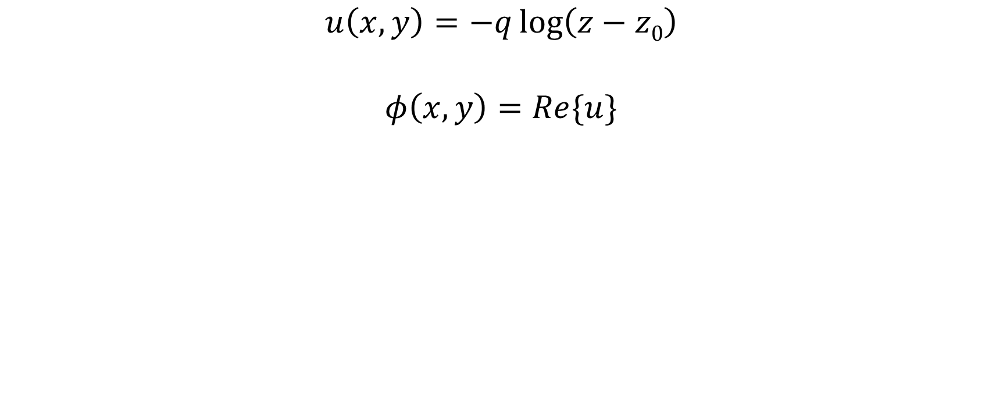
The potential (in complex variables – for FMM)
$$u\left(x,y\right)=−q\log\left(z−z0\right)$$
$$φ\left(x,y\right)=Re\{u\}$$

Slide 9
The Barnes-Hut Algorithm
Basic idea:
Hierarchically group particles
If far, make approximations (source representation)
Stages:
Tree construction
Potential evaluation

Slide 10
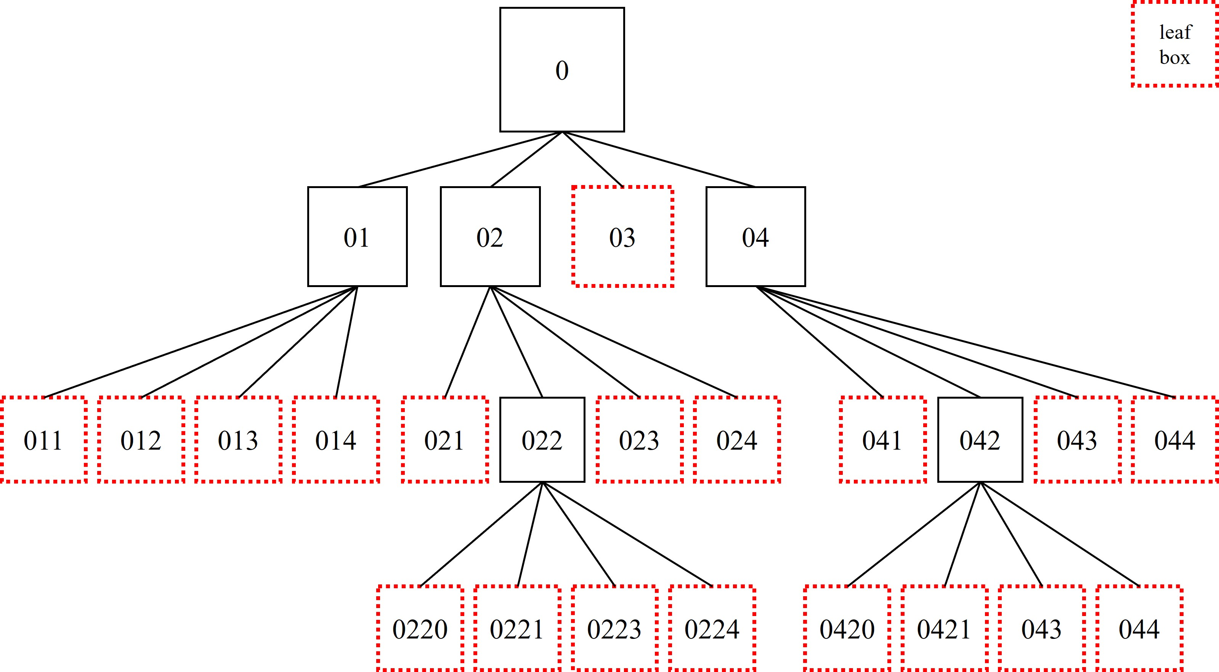
The Hierarchical Tree (Barnes-Hut)

Slide 11
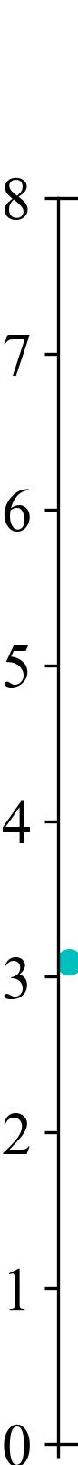
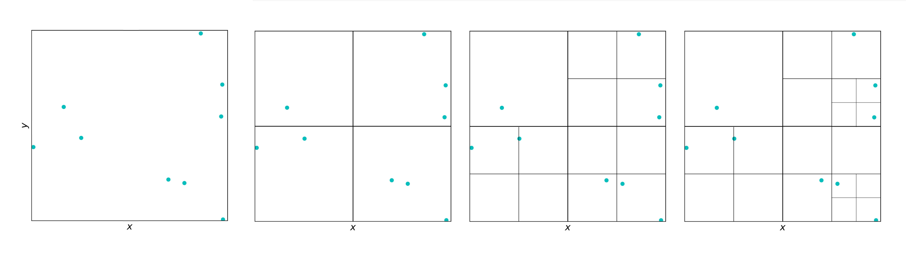
The Hierarchical Tree (Barnes-Hut)
s
s
s
043
044
s
03
04
041
042
0423
0424
R
0421
0422
0
013
014
023
024
01
02
011
012
021
022
0223
0224
0220
0221
Level
0
1
2
3
Higher level (finer division)

Slide 12
Separation parameter θ (what is far?)
s
s
s
043
044
s
03
04
✓
041
042
0423
0424
R
0421
0422
0
013
014
023
024
01
02
x
0223
0224
target
011
012
021
022
0220
0221
Level
0
1
2
3
s
θ=1/2
R₁
s/R₁ < θ (source group far enough from target, can approximate as point mass)
R₂
✓
s/R₂ > θ (source group close to target, go to a finer level)
x

Slide 13
Evaluating the potential
s
s
s
043
044
s
03
04
leaf
✓
041
042
0423
0424
R
c.o.m.
0421
0422
0
x
leaf
target
x
013
014
023
024
01
02
leaf
x
0223
0224
011
012
021
022
✓
0220
0221
Level
0
1
2
3
s
θ=1/2
R₁
s/R₁ < θ (source group far enough from target, can approximate as point mass)
R₂
✓
s/R₂ > θ (source group close to target, go to a finer level)
x

Slide 14
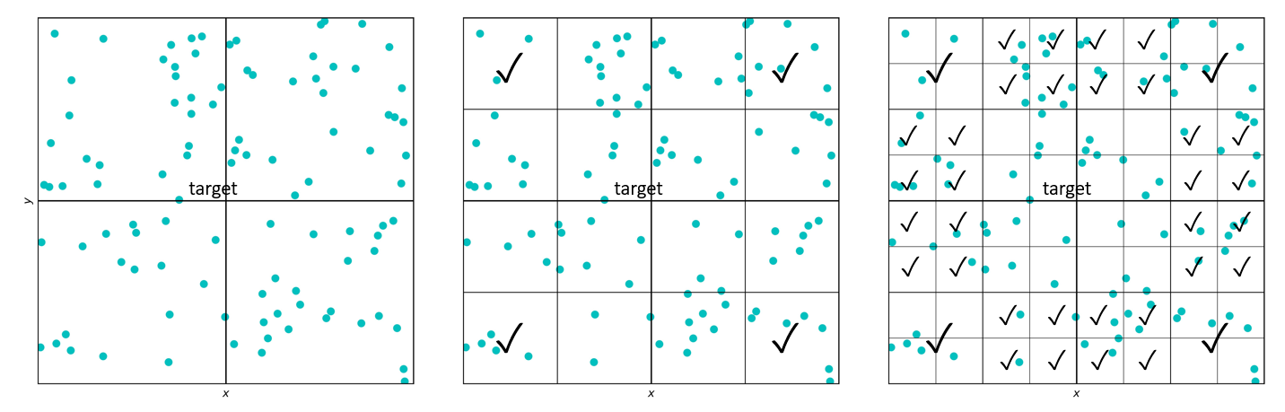
Time Complexity (Barnes-Hut)
Tree construction O (N logN )
Number of particles: N
Assume uniform ∴N particles at leaf level L ∴ N = 4^{L}
∴ Number of levels: L = log₄N = O (log N)
A particle contributes to the c.o.m. at each of the L levels.
This is repeated for N particles.
∴ N ×L = O (N logN )
(note that this takes into account the binary search to allocate particles into boxes.)
Aside: Total number of boxes: 1 + 4 + 4² + … + 4^{L} = O (4^{L}) = O (N )
Potential evaluation O (N logN )
Each level sweeps out a constant number of boxes.
L levels are swept for each of the N particles.
∴ N ×L = O (N logN )

Slide 15
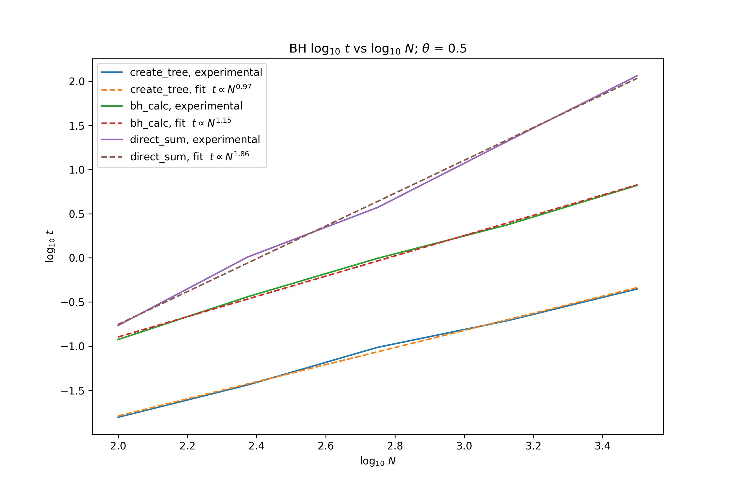
Time Complexity (Barnes-Hut)
Direct sum
Barnes-Hut
Barnes-Hut Tree Creation

Slide 16
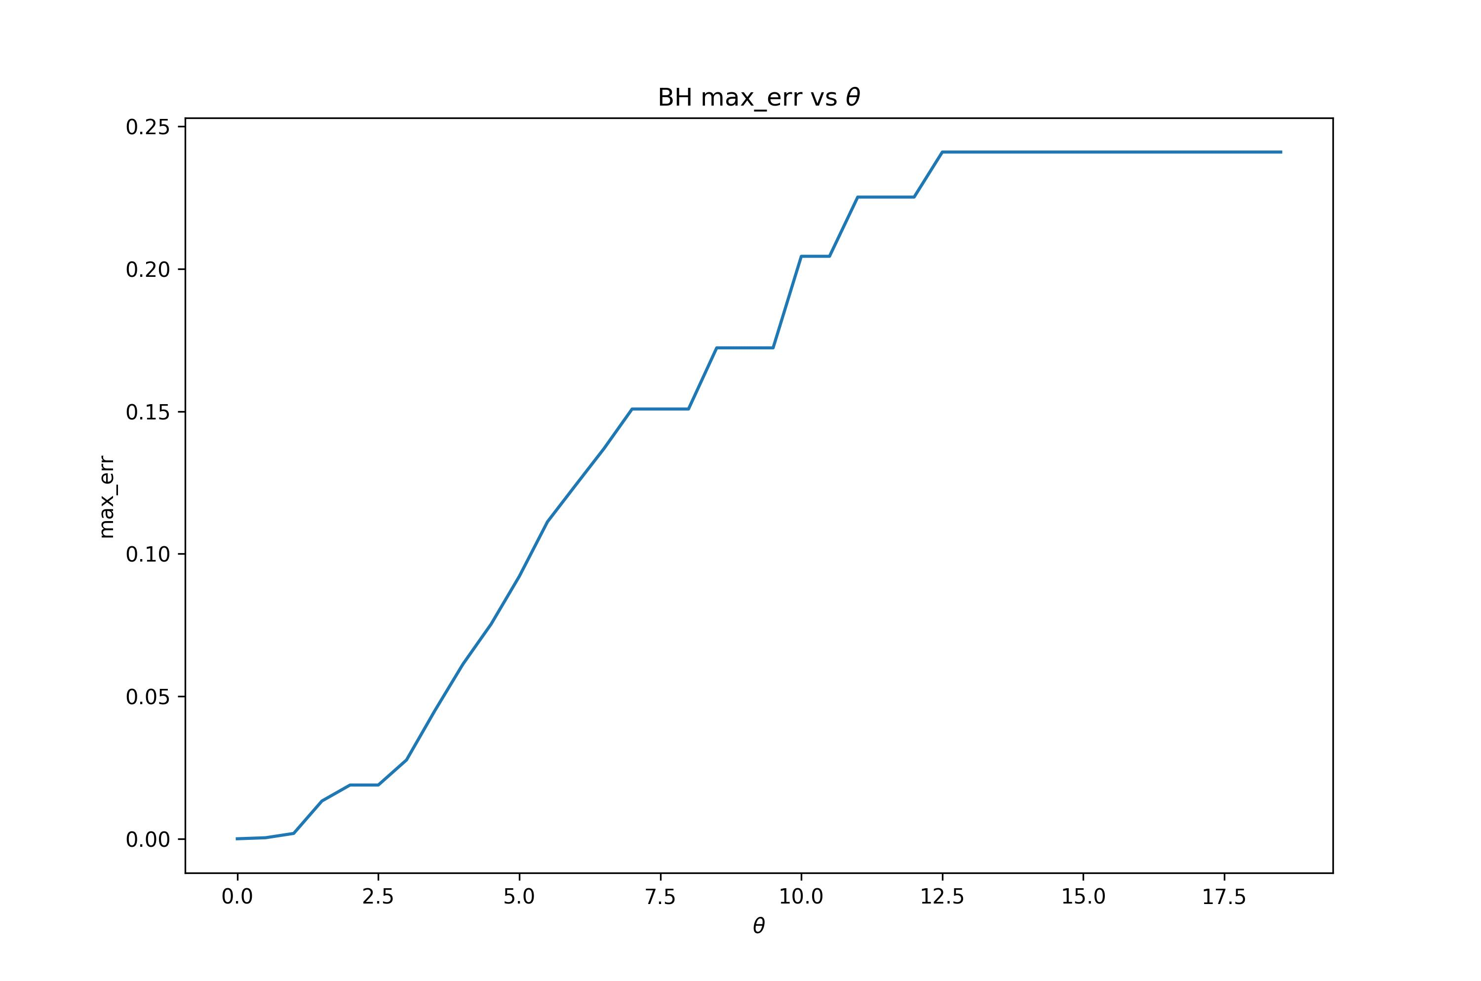
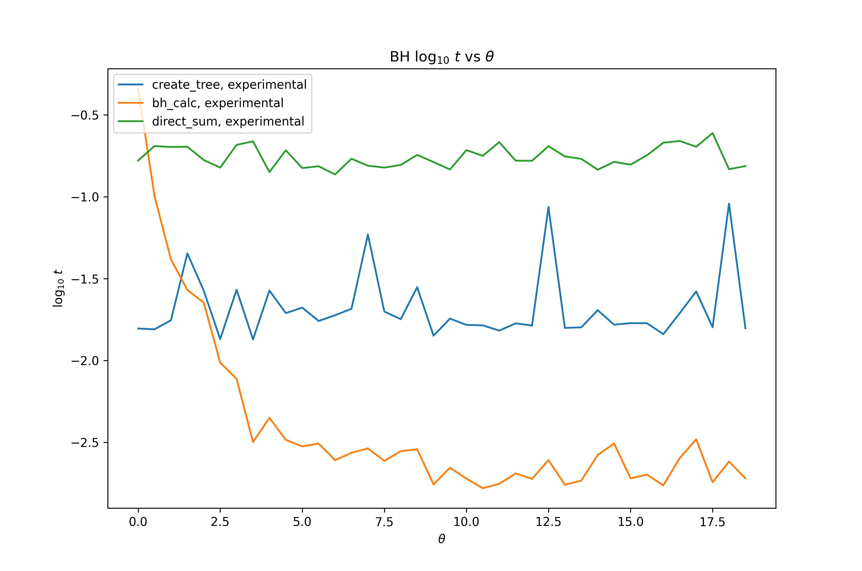
Problems with the Barnes-Hut Method
Limited precision
Could improve precision by decreasing separation parameter θ
(more particles will be classified as “close”)
However, this would eventually reduce to a direct summation -O (N ²).
Direct sum
θ decreases, error decreases
θ decreases, runtime increases
Barnes-Hut

Slide 17
The Fast Multipole Method (FMM)
Basic idea:
Hierarchically group particles
If far, make approximations (source and target representations)
Approximations are made using series expansions (up to order p )
Pass down repeated information
Stages:
Tree construction
Potential evaluation (The 6 Steps)

Slide 18
Source and Target representations

Slide 19
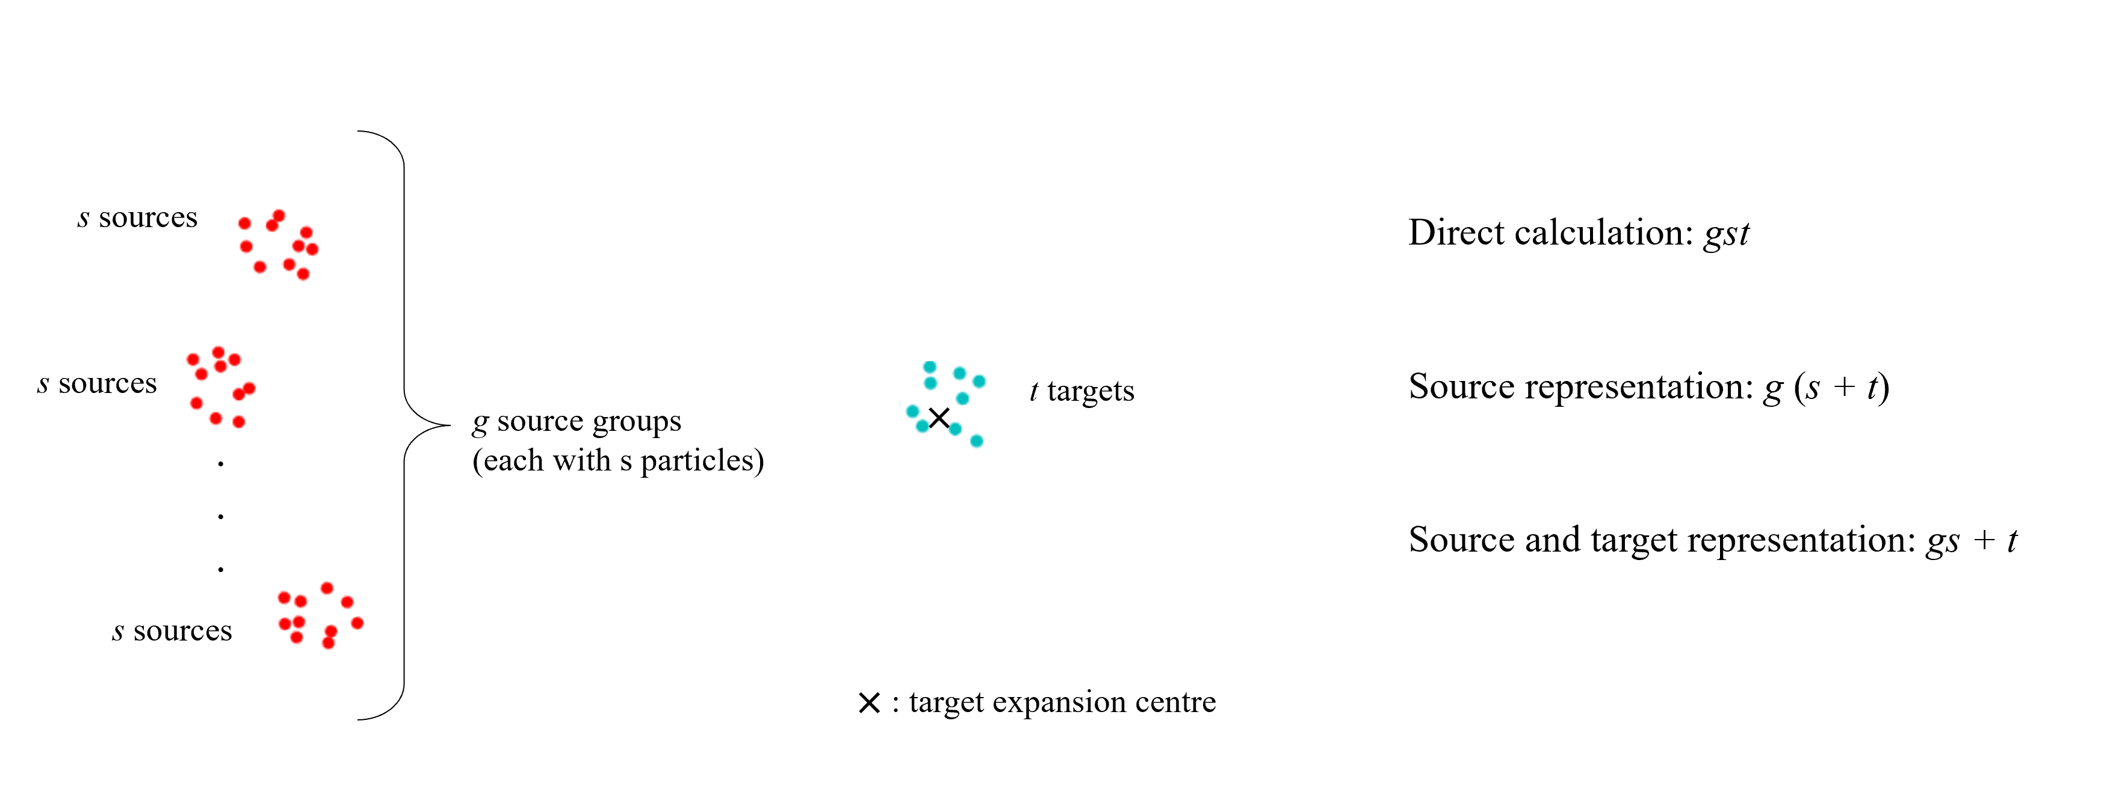
Target representation (multiple source groups)

Slide 20

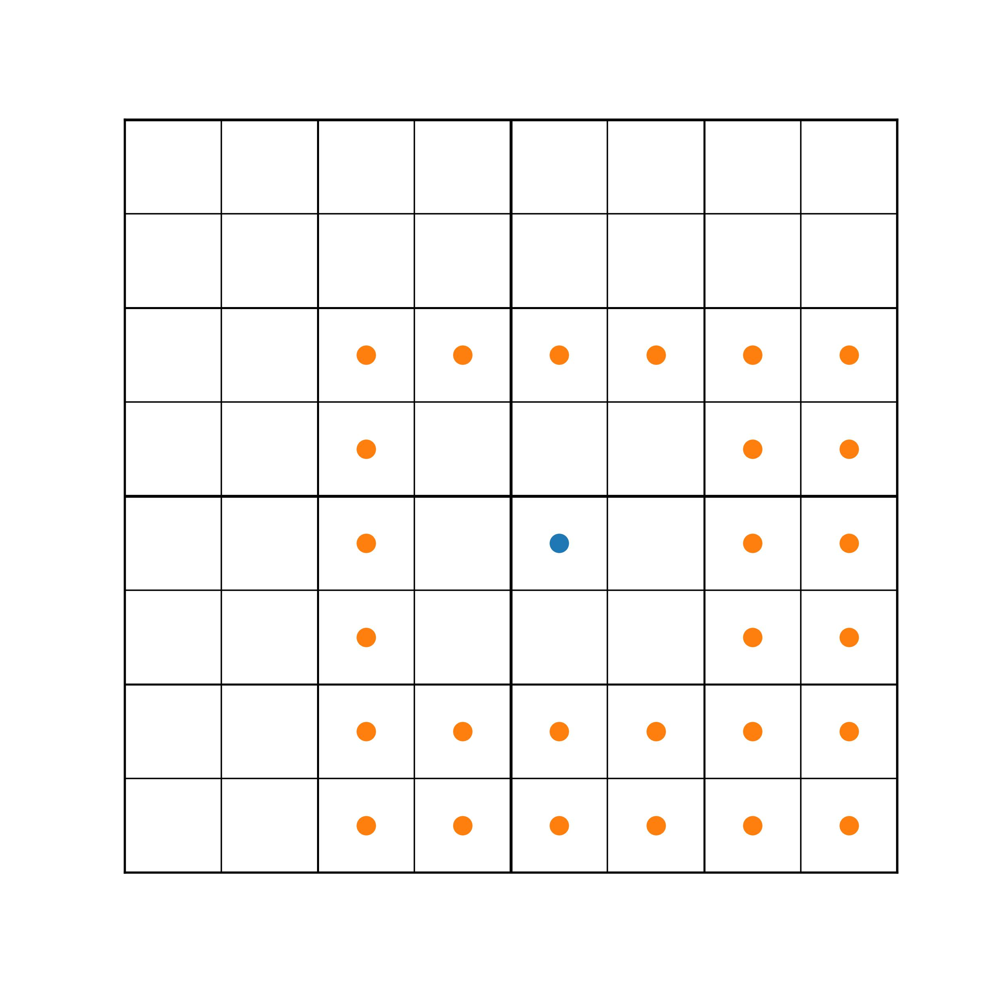
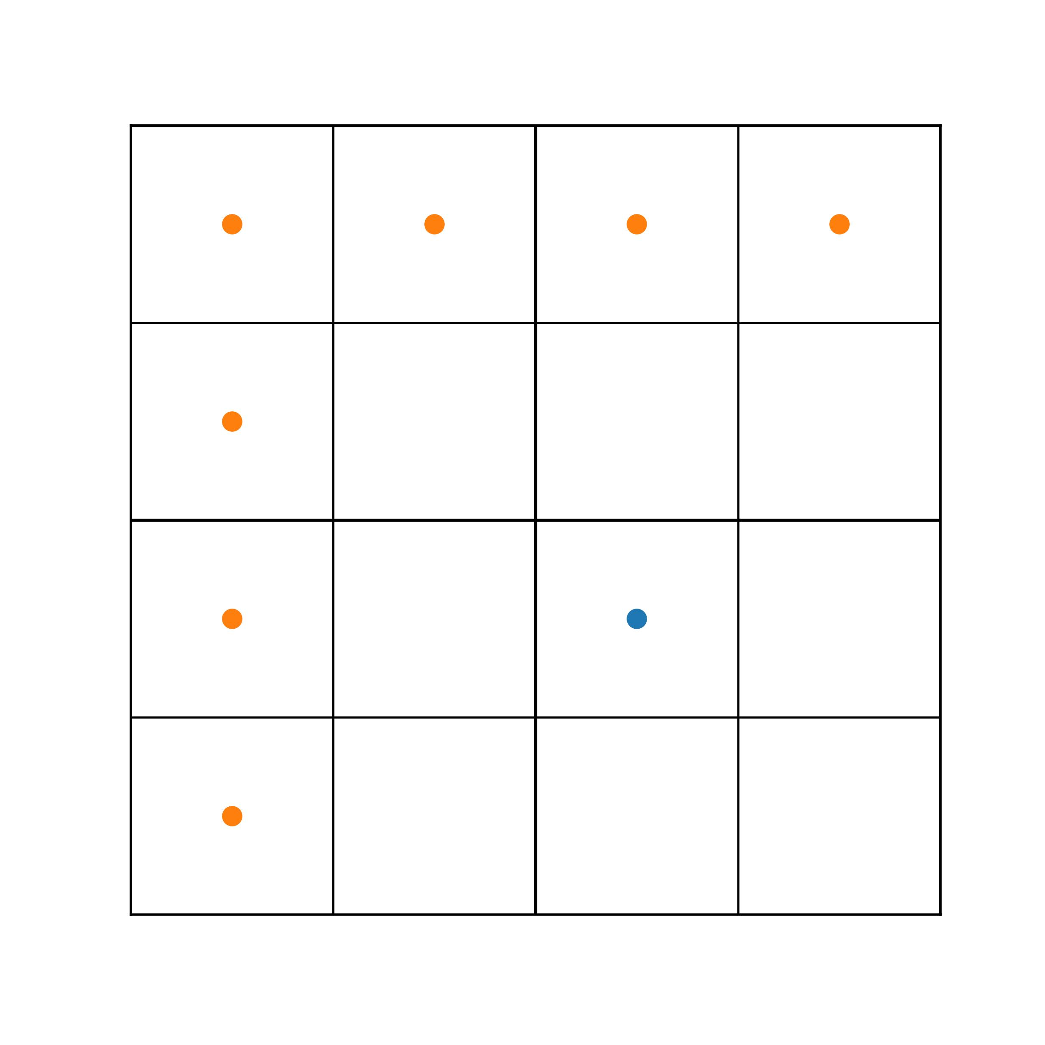
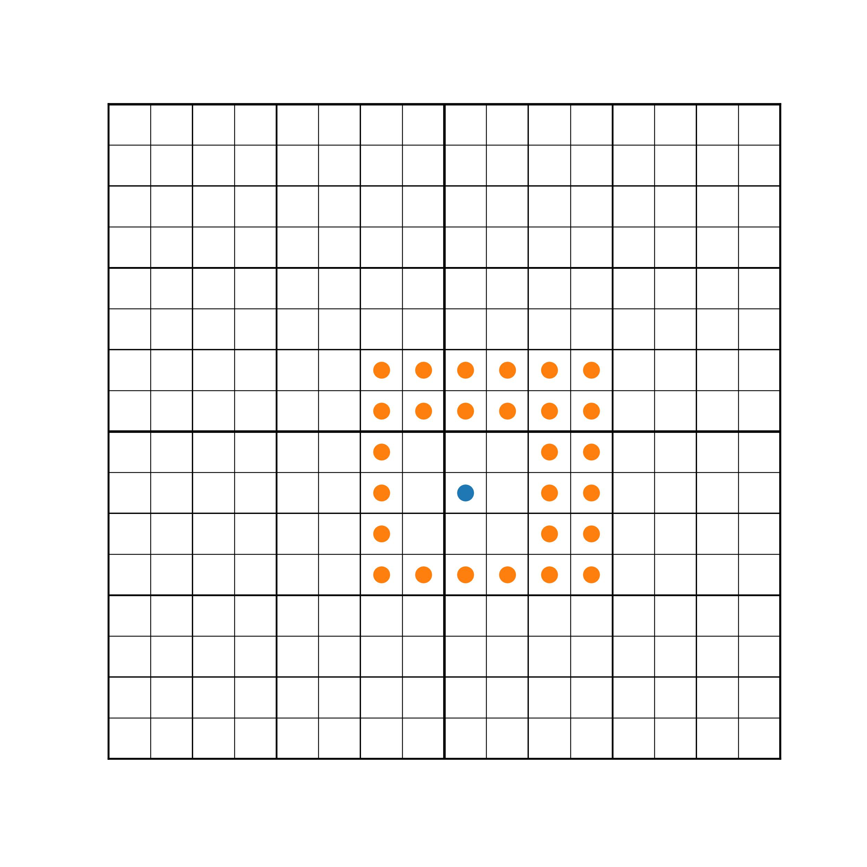
Core Step (M2L – see later)
Interaction list (far source representations)
Target box
…
…

Slide 21
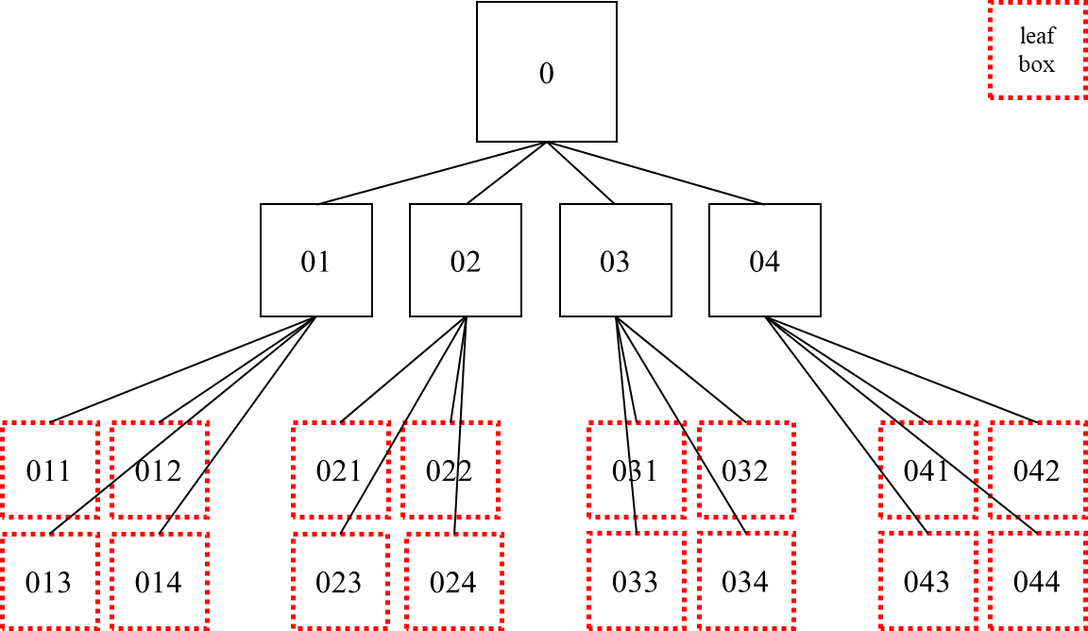
Tree Construction (FMM)
Similar to the Barnes-Hut tree
But different construction mechanism
Particles only assigned at leaf level
Fixed maximum number m of particles at leaf level
instead of 1 – Barnes-Hut
m ~ O (1)

Slide 22
The 6 steps
Source to Multipole (S2M)
Multipole to Multipole (M2M)
Multipole to Local (M2L)
Local to Local (L2L)
Local to Particle (L2P)
Particle to Particle (P2P)

Slide 23
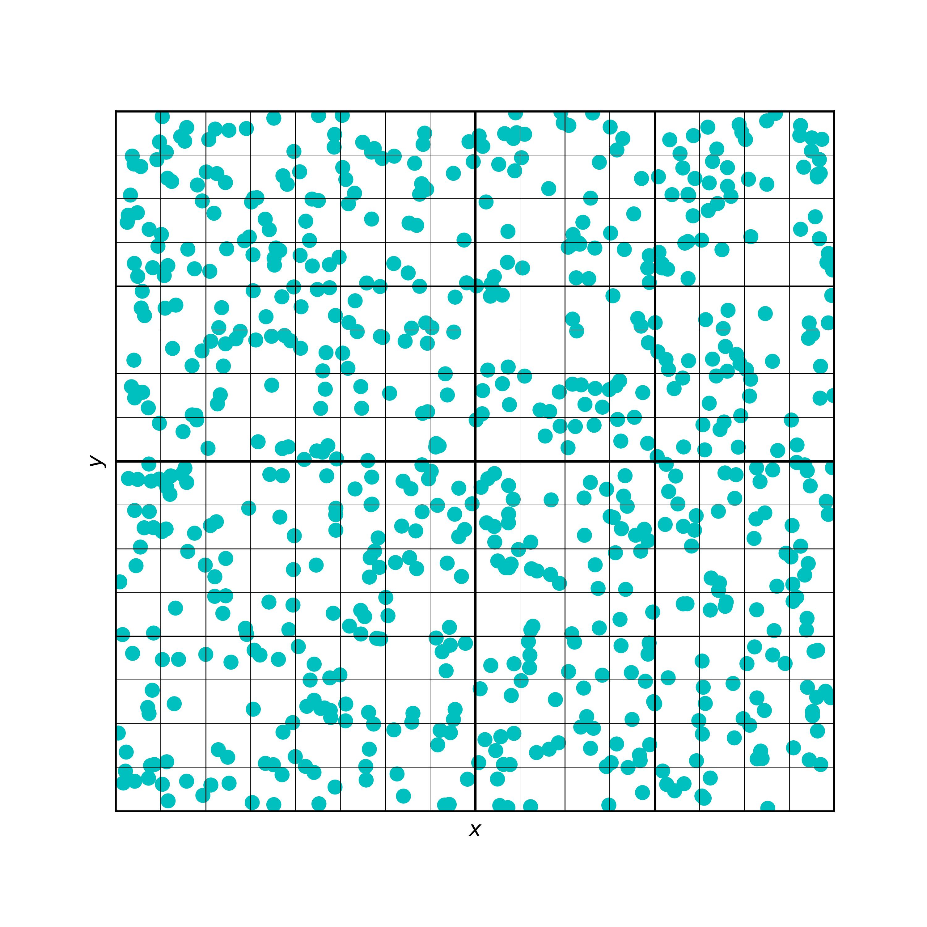
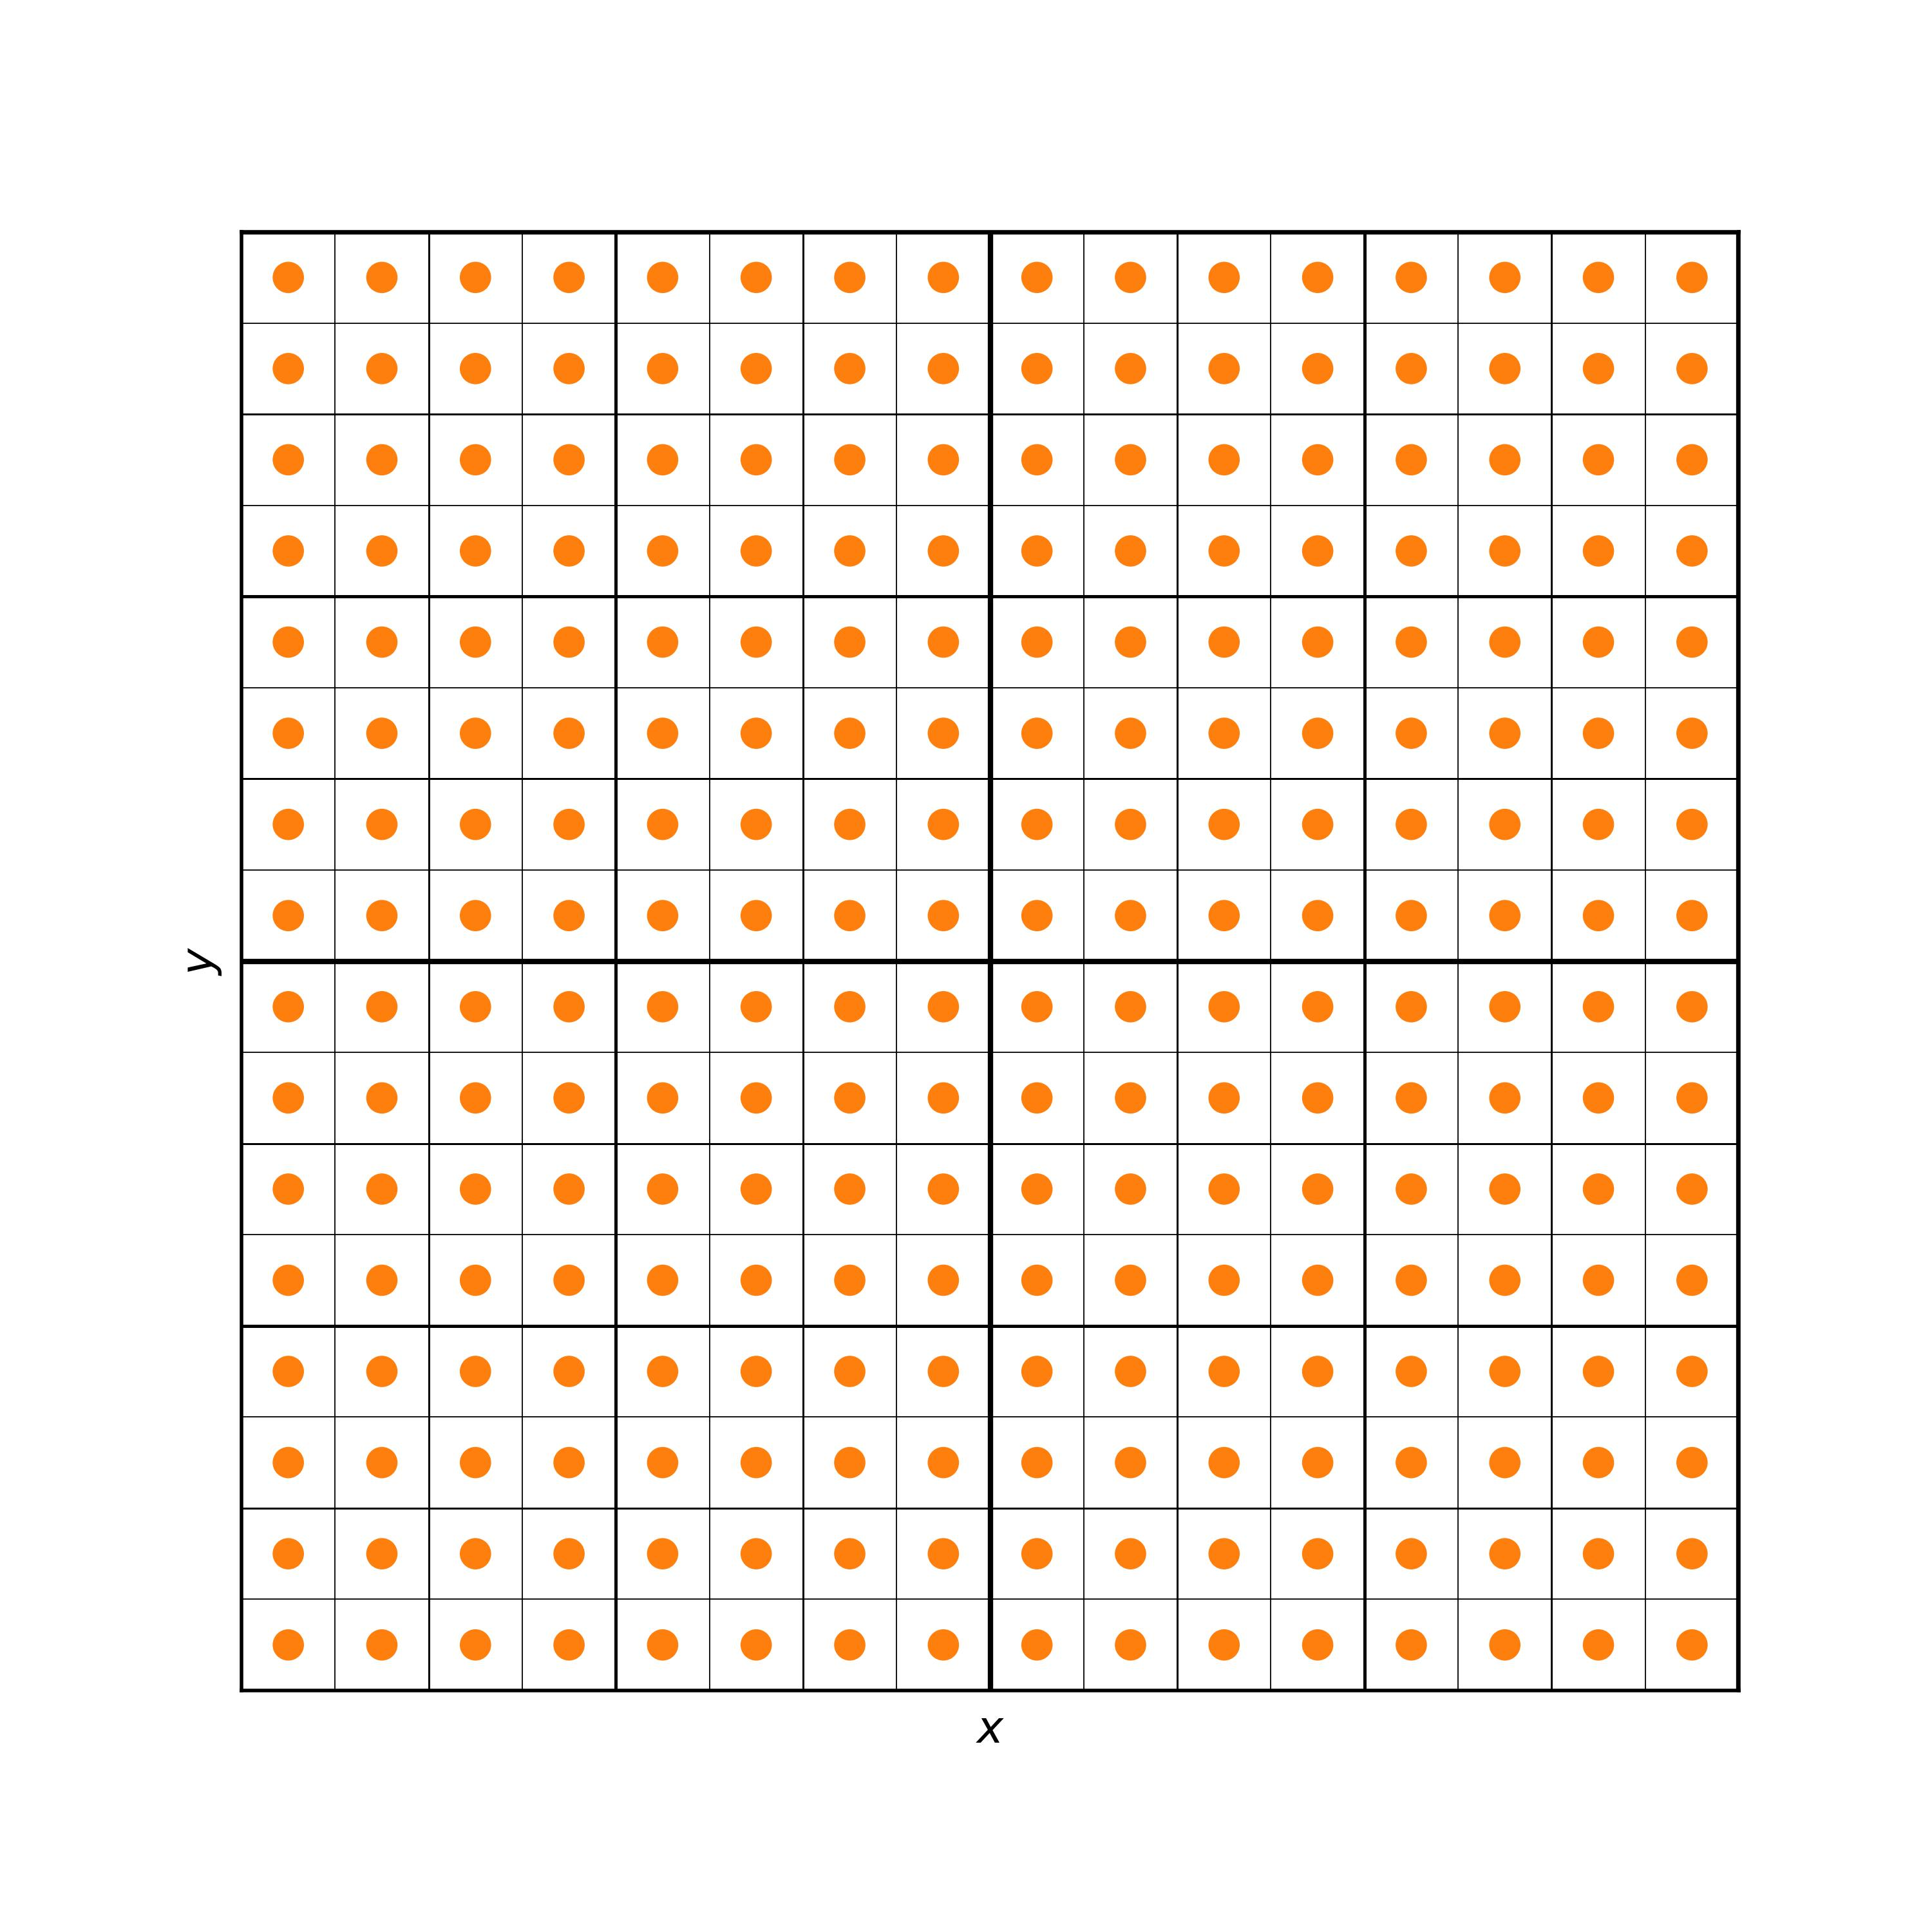
The 6 steps (S2M)
Source to Multipole (S2M)
- Creating source representations
E.g.
N = 700
m = 7
sources
Source representations

Slide 24
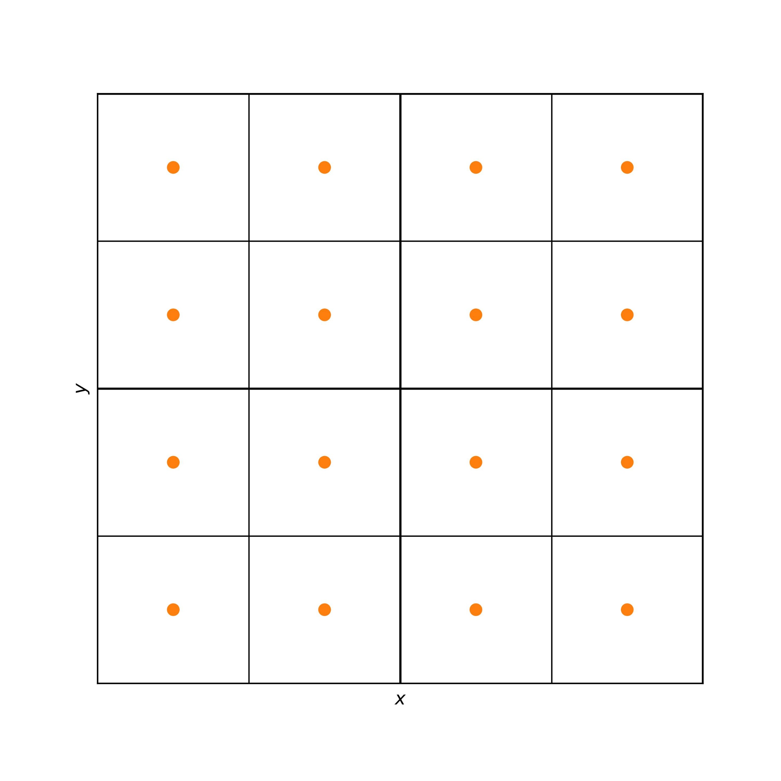
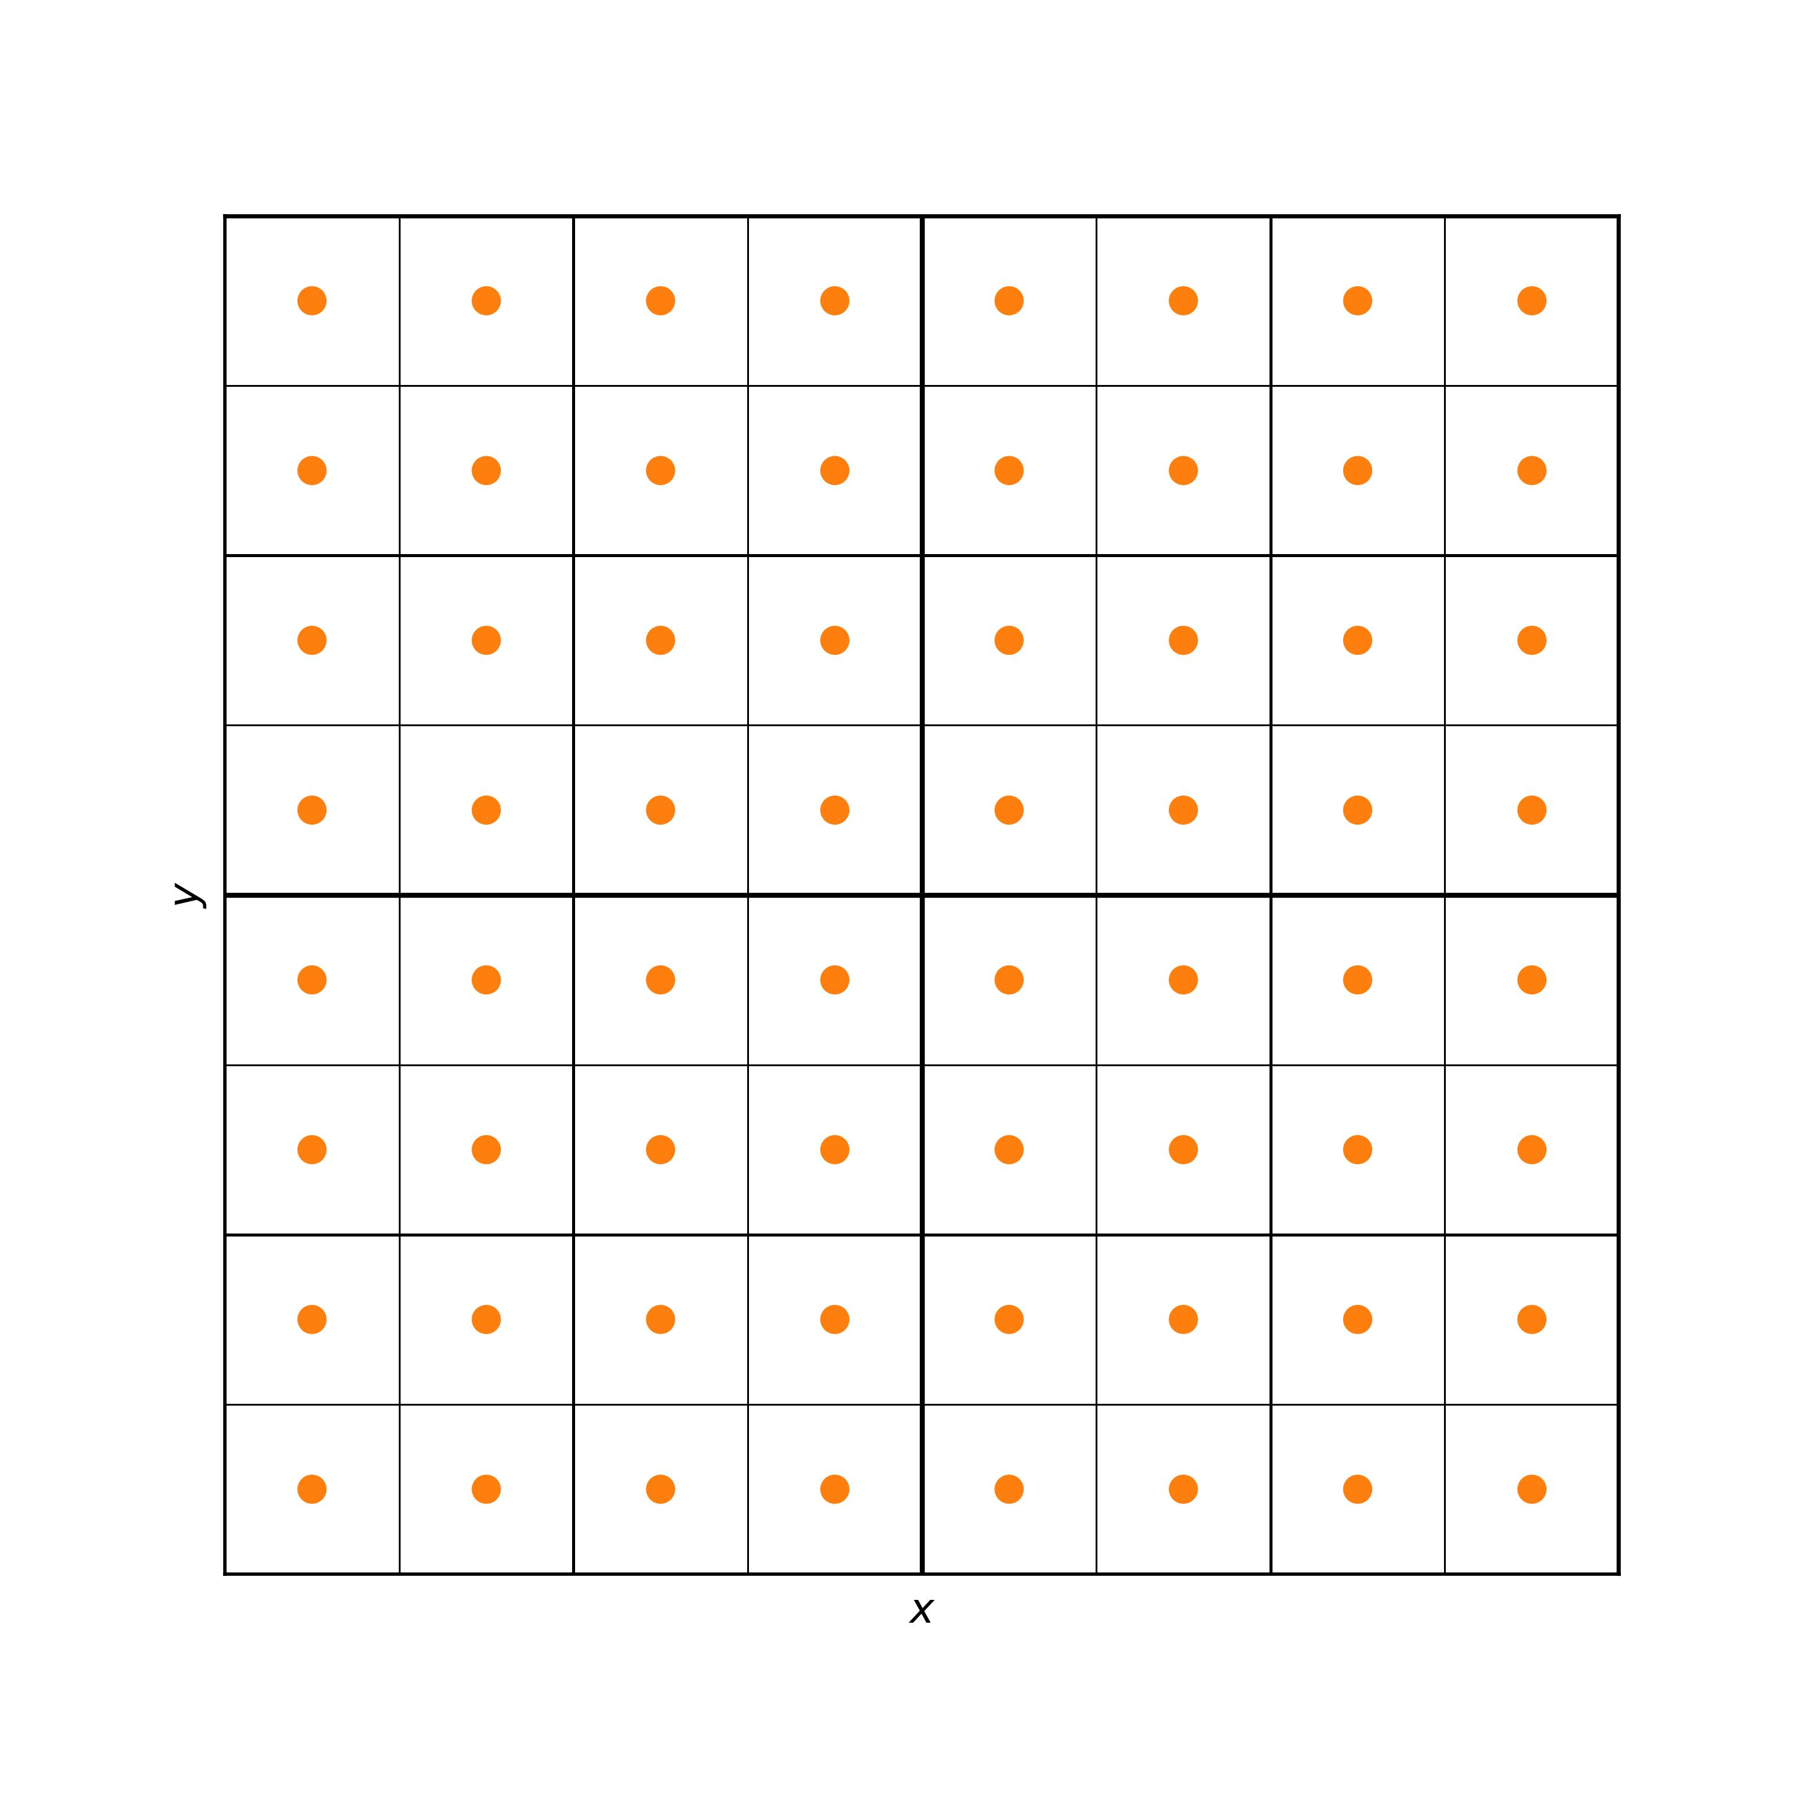
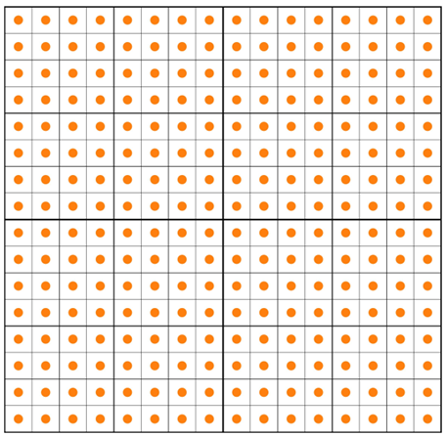
The 6 steps (M2M)
Source to Multipole (S2M)
Multipole to Multipole (M2M)
- Creating source representations
- Transferring source representations

Slide 25
The 6 steps (M2L)
Source to Multipole (S2M)
Multipole to Multipole (M2M)
Multipole to Local (M2L)
- Creating source representations
- Transferring source representations
- Evaluating target representations
(from far source representations)
Interaction list (far source representations)
Target box
…
…

Slide 26
The 6 steps (L2L)
Source to Multipole (S2M)
Multipole to Multipole (M2M)
Multipole to Local (M2L)
Local to Local (L2L)
- Creating source representations
- Transferring source representations
- Evaluating target representations
- Transferring target representations
Interaction list
Target box
…
…
M2L
M2L
…
M2L
L2L
L2L

Slide 27
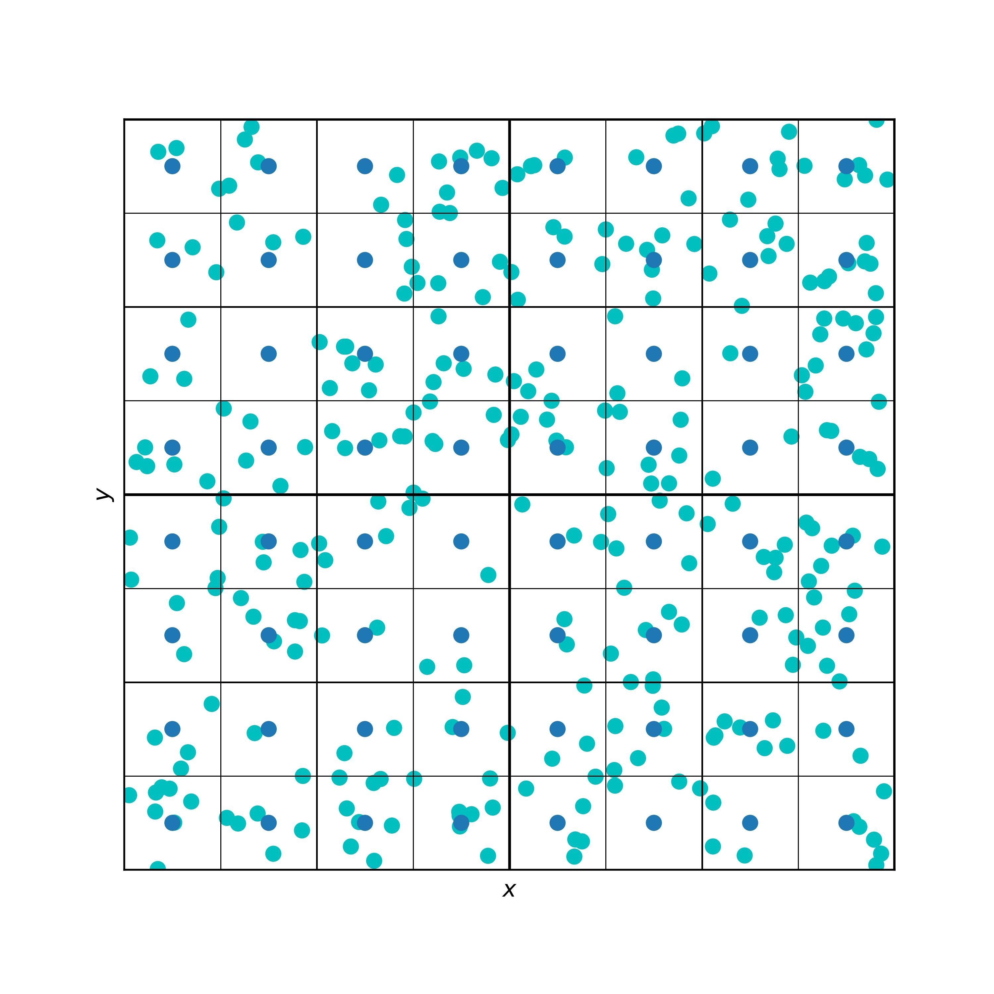
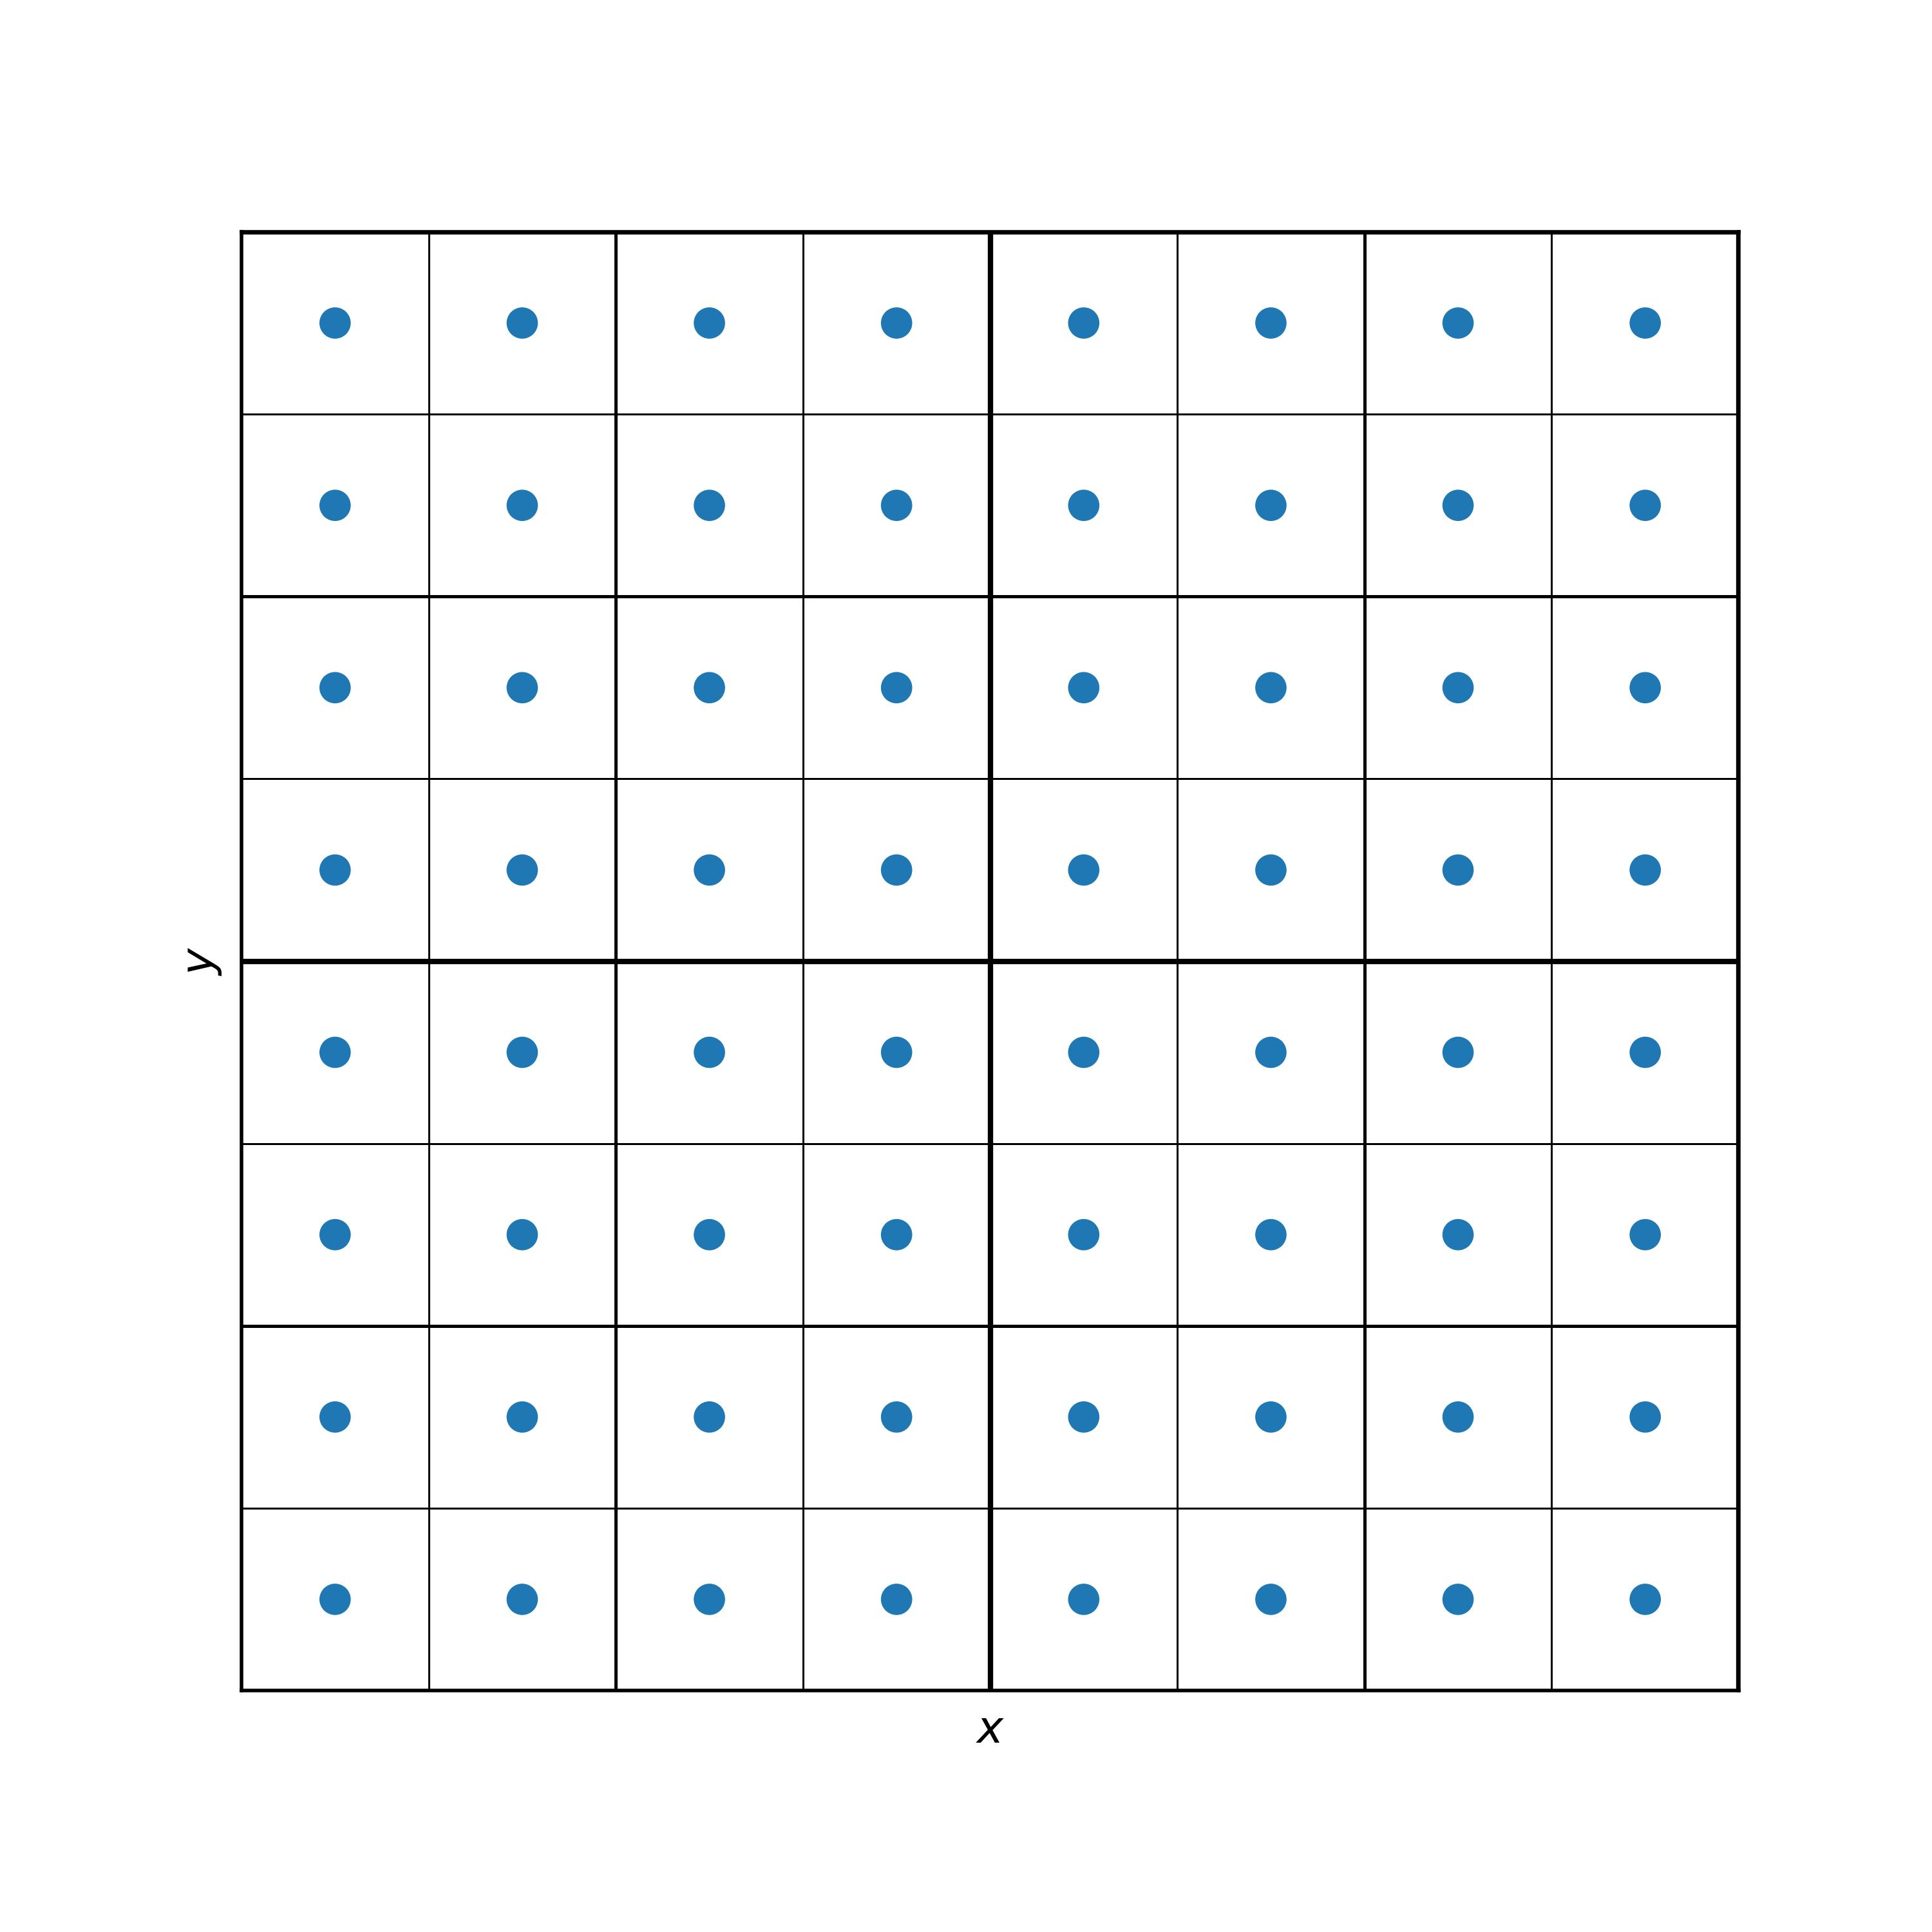
The 6 steps (L2P)
Source to Multipole (S2M)
Multipole to Multipole (M2M)
Multipole to Local (M2L)
Local to Local (L2L)
Local to Particle (L2P)
- Creating source representations
- Transferring source representations
- Evaluating target representations
- Transferring target representations
- Using target representations
(to evaluate the potential at the particle locations)

Slide 28
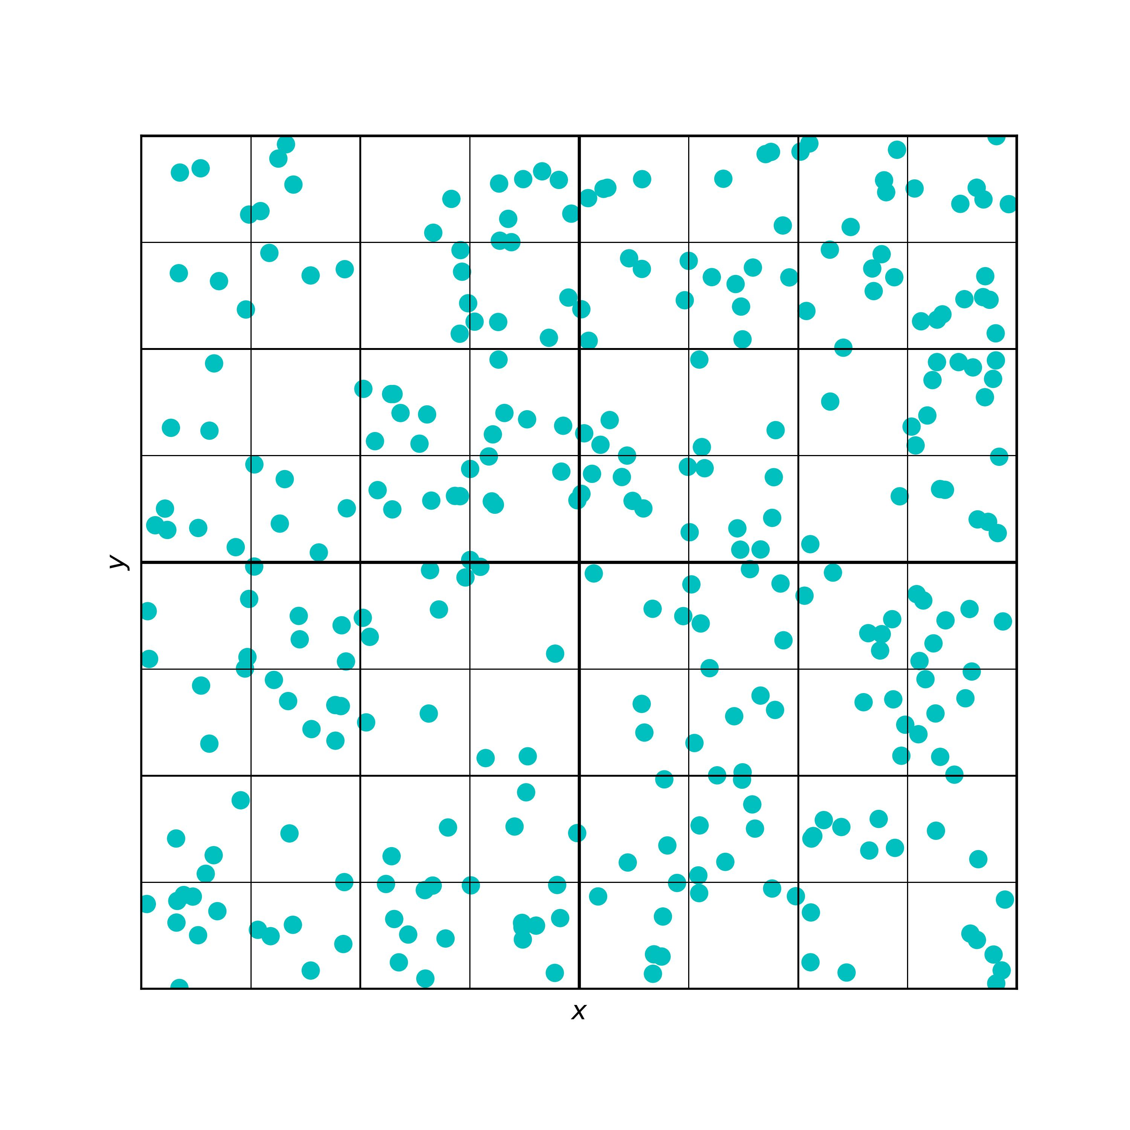
The 6 steps (P2P)
Source to Multipole (S2M)
Multipole to Multipole (M2M)
Multipole to Local (M2L)
Local to Local (L2L)
Local to Particle (L2P)
Particle to Particle (P2P)
- Creating source representations
- Transferring source representations
- Evaluating target representations
- Transferring target representations
- Using target representations
- Evaluating potential directly
(from leftover nearby sources)

Slide 29
The 6 steps
Source to Multipole (S2M)
Multipole to Multipole (M2M)
Multipole to Local (M2L)
Local to Local (L2L)
Local to Particle (L2P)
Particle to Particle (P2P)
- Creating source representations
- Transferring source representations
- Evaluating target representations
- Transferring target representations
- Using target representations
- Evaluating potential directly

Slide 30
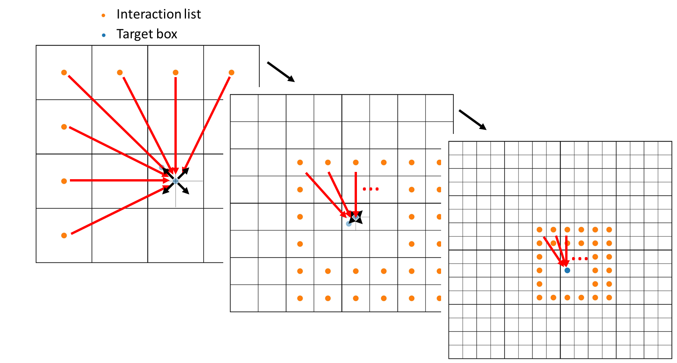
The 6 steps (FMM)
M2M
S2M
Transfer source representations
sources
Source representations
M2L
Evaluate target representations
L2L
Transfer target representations
L2P
P2P
Using target representations
Evaluate potential directly

Slide 31
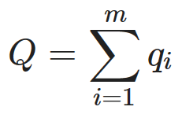
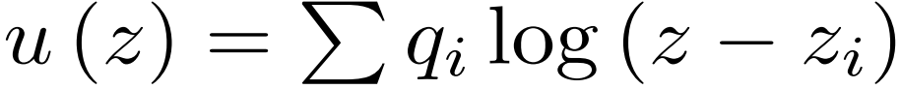
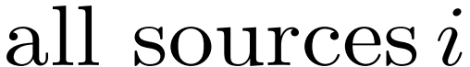
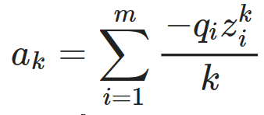
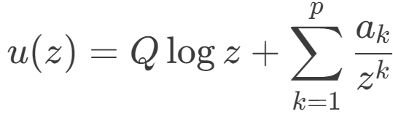
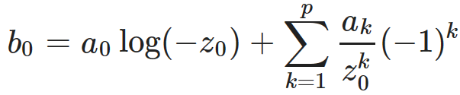
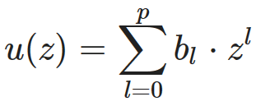
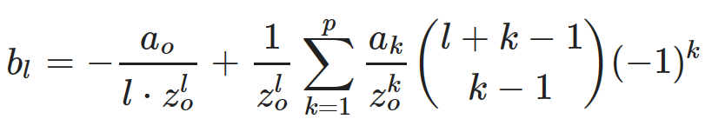
The math behind the six steps
Potential definition (̀single source)
Target location
Source charge
Source location
Source rep calculation
Direct sum over all sources
P2P
S2M
Source representation
Target rep calculation
M2L
Target representation
L2P
M2M, L2L are translations, not shown here

Slide 32
The math
Definition
Source representation
Source to Multipole (S2M)
Multipole to Multipole (M2M)
Multipole to Local (M2L)
Local to Local (L2L)
Local to Particle (L2P)
Particle to Particle (P2P)

Slide 33
Interaction list
Target box
…
…

Slide 34
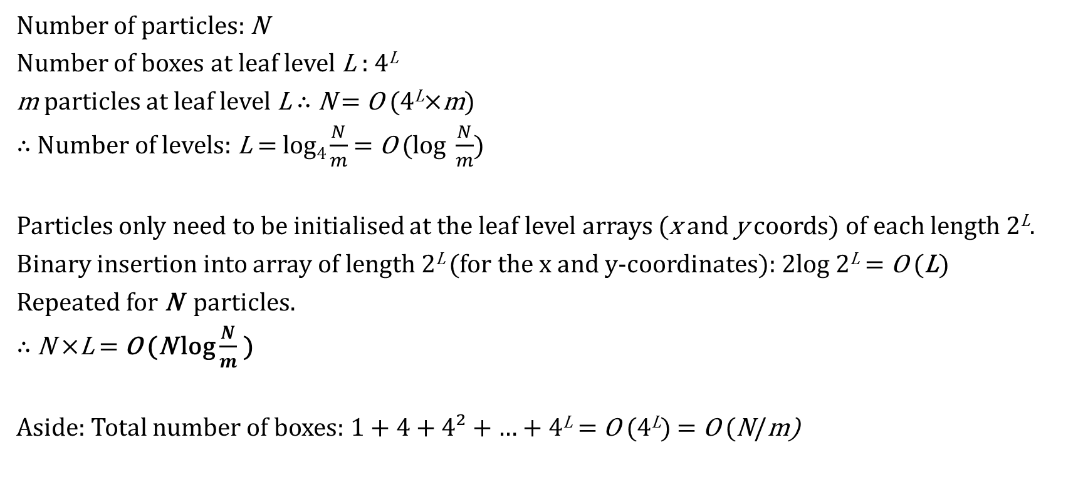
Time Complexity (FMM) Tree construction O (N log N )
Number of particles: N
Number of boxes at leaf level L : 4^{L}
m particles at leaf level L ∴ N = O (4^{L}×m)
∴ Number of levels: L = log₄ $\frac{N}{m}$ = O (log $\frac{N}{m}$)
Particles only need to be initialised at the leaf level arrays (x and y coords) of each length 2^{L}.
Binary insertion into array of length 2^{L} (for the x and y-coordinates): 2log 2^{L} = O (L)
Repeated for N particles.
∴ N ×L = O (N log $\frac{N}{m}$ )
Aside: Total number of boxes: 1 + 4 + 4² + … + 4^{L} = O (4^{L}) = O (N/m)

Slide 35
Time Complexity (FMM) Potential evaluation O (N )
M2L dominates (see later)
Source to Multipole (S2M)
Multipole to Multipole (M2M)
Multipole to Local (M2L)
Local to Local (L2L)
Local to Particle (L2P)
Particle to Particle (P2P)
Np
Np² /m
27Np²/m
Np²/m
Np
9Nm
N : # particles
p : order of expansion
m : maximum # particles at leaf level

Slide 36

Time Complexity (FMM) Potential evaluation O (N )
N : # particles
p : order of expansion
m : maximum # particles at leaf level
Source to Multipole (S2M)
Multipole to Multipole (M2M)
Multipole to Local (M2L)
Local to Local (L2L)
Local to Particle (L2P)
Particle to Particle (P2P)
Np
Np² /m
27Np²/m
Np²/m
Np
9Nm
- Each box consists of 6² - 3² = 27 boxes in their interaction list.
- Each M2L operation involves p ² steps.
- This operation is carried out for N/m boxes (summed across all levels).

Slide 37
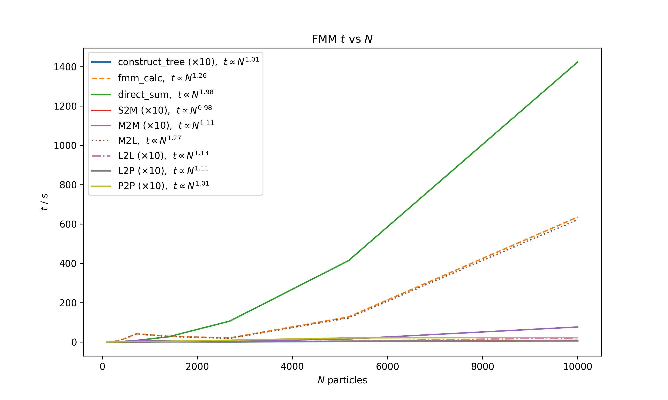
Time Complexity (FMM) – varying N
Direct sum
FMM overall
(sum of 6 components)
M2L
Dominates FMM
Other 5 steps, tree construction (×10)

Slide 38
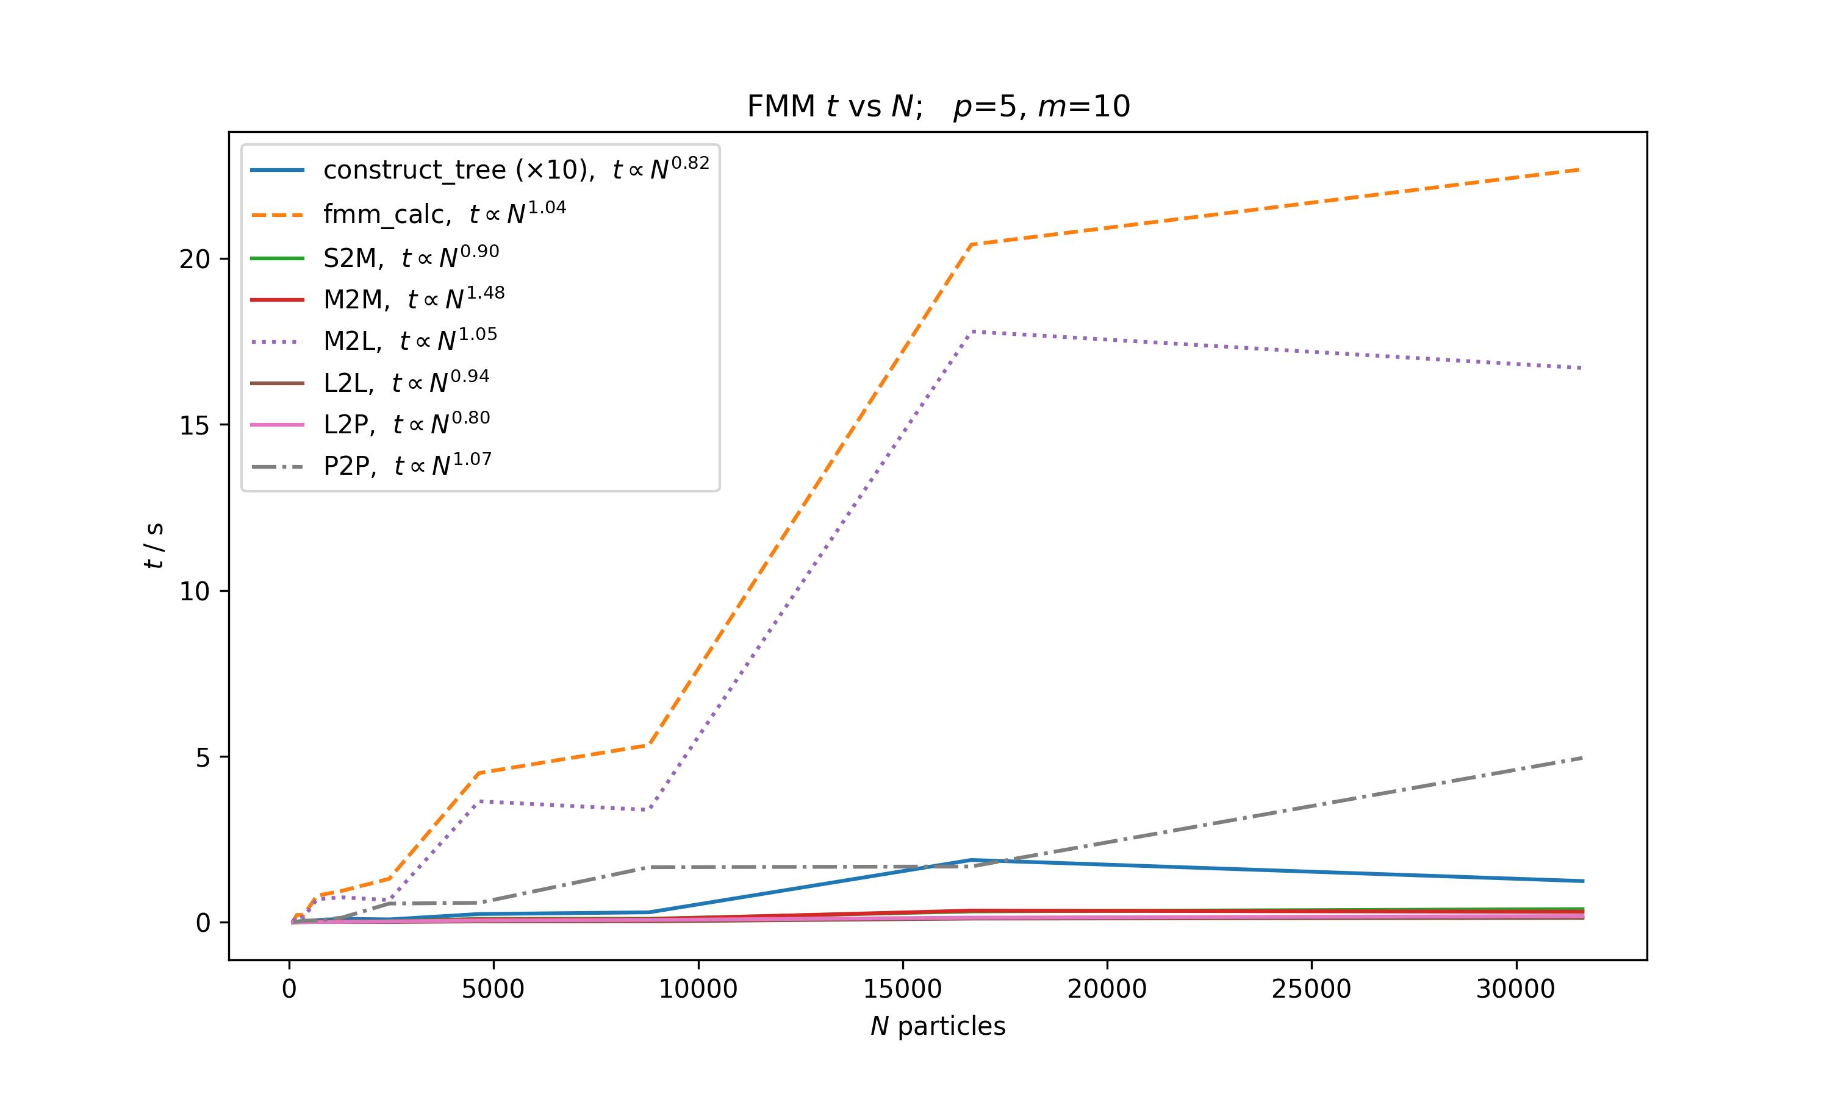
Time Complexity (FMM) – varying N
FMM overall
(sum of 6 components)
M2L
Dominates FMM
Tree construction (×10)

Slide 39
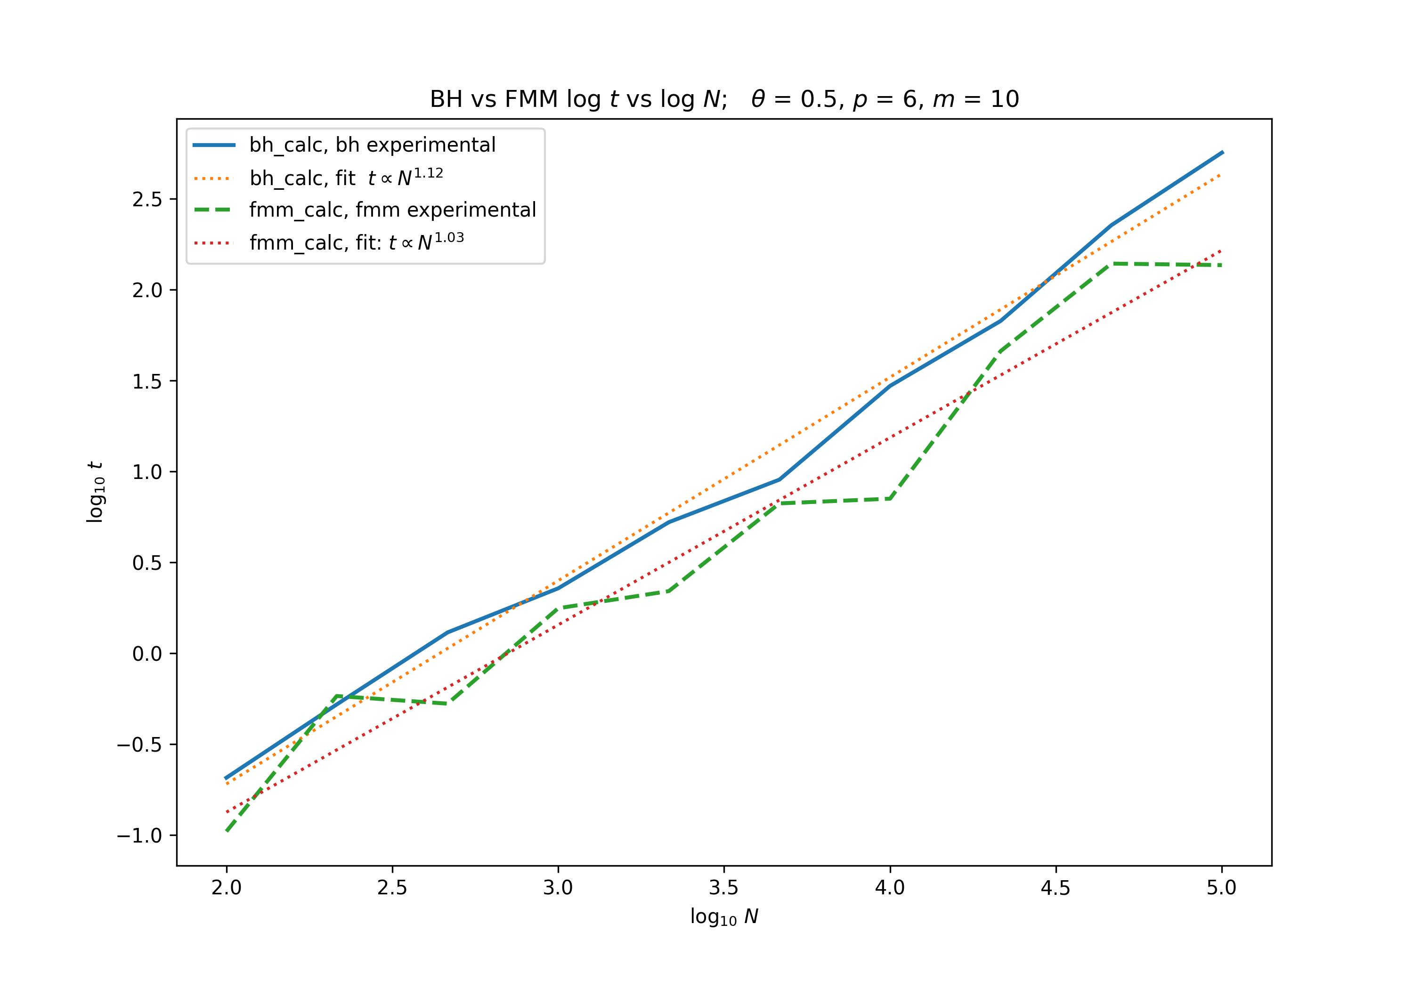
Time Complexity (FMM) – varying N
Barnes-Hut
FMM overall
(sum of 6 components)
N.B. Tree construction ignored

Slide 40
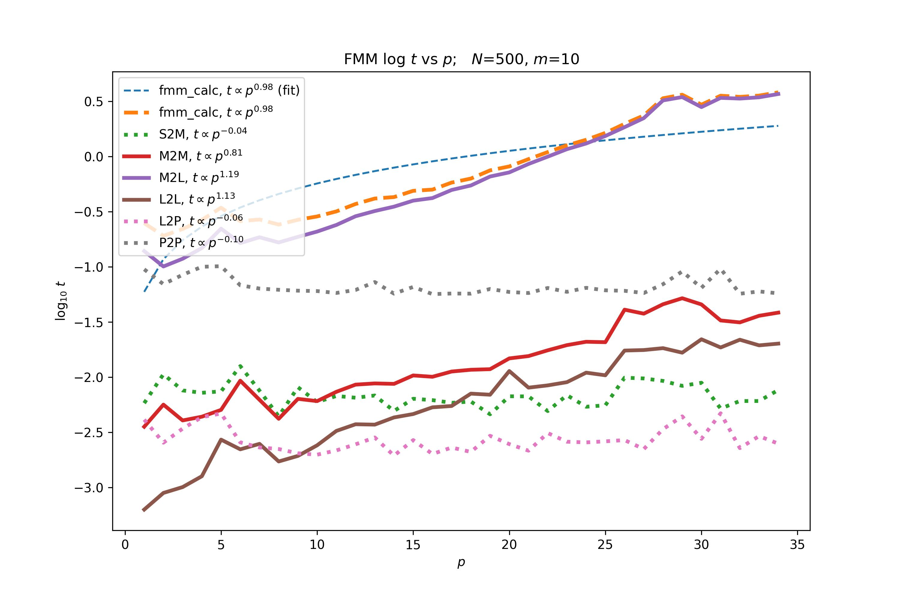
Time Complexity (FMM) – varying p
All errors are approximately 1 power lower than expected

Slide 41
Recall
Source to Multipole (S2M)
Multipole to Multipole (M2M)
Multipole to Local (M2L)
Local to Local (L2L)
Local to Particle (L2P)
Particle to Particle (P2P)
Np
Np² /m
27Np²/m
Np²/m
Np
9Nm
All errors are approximately 1 power lower than expected
Possibly due to numpy vectorisation
some operations requires a loop – O (p)
others act on the entire array at once – O (1)

Slide 42
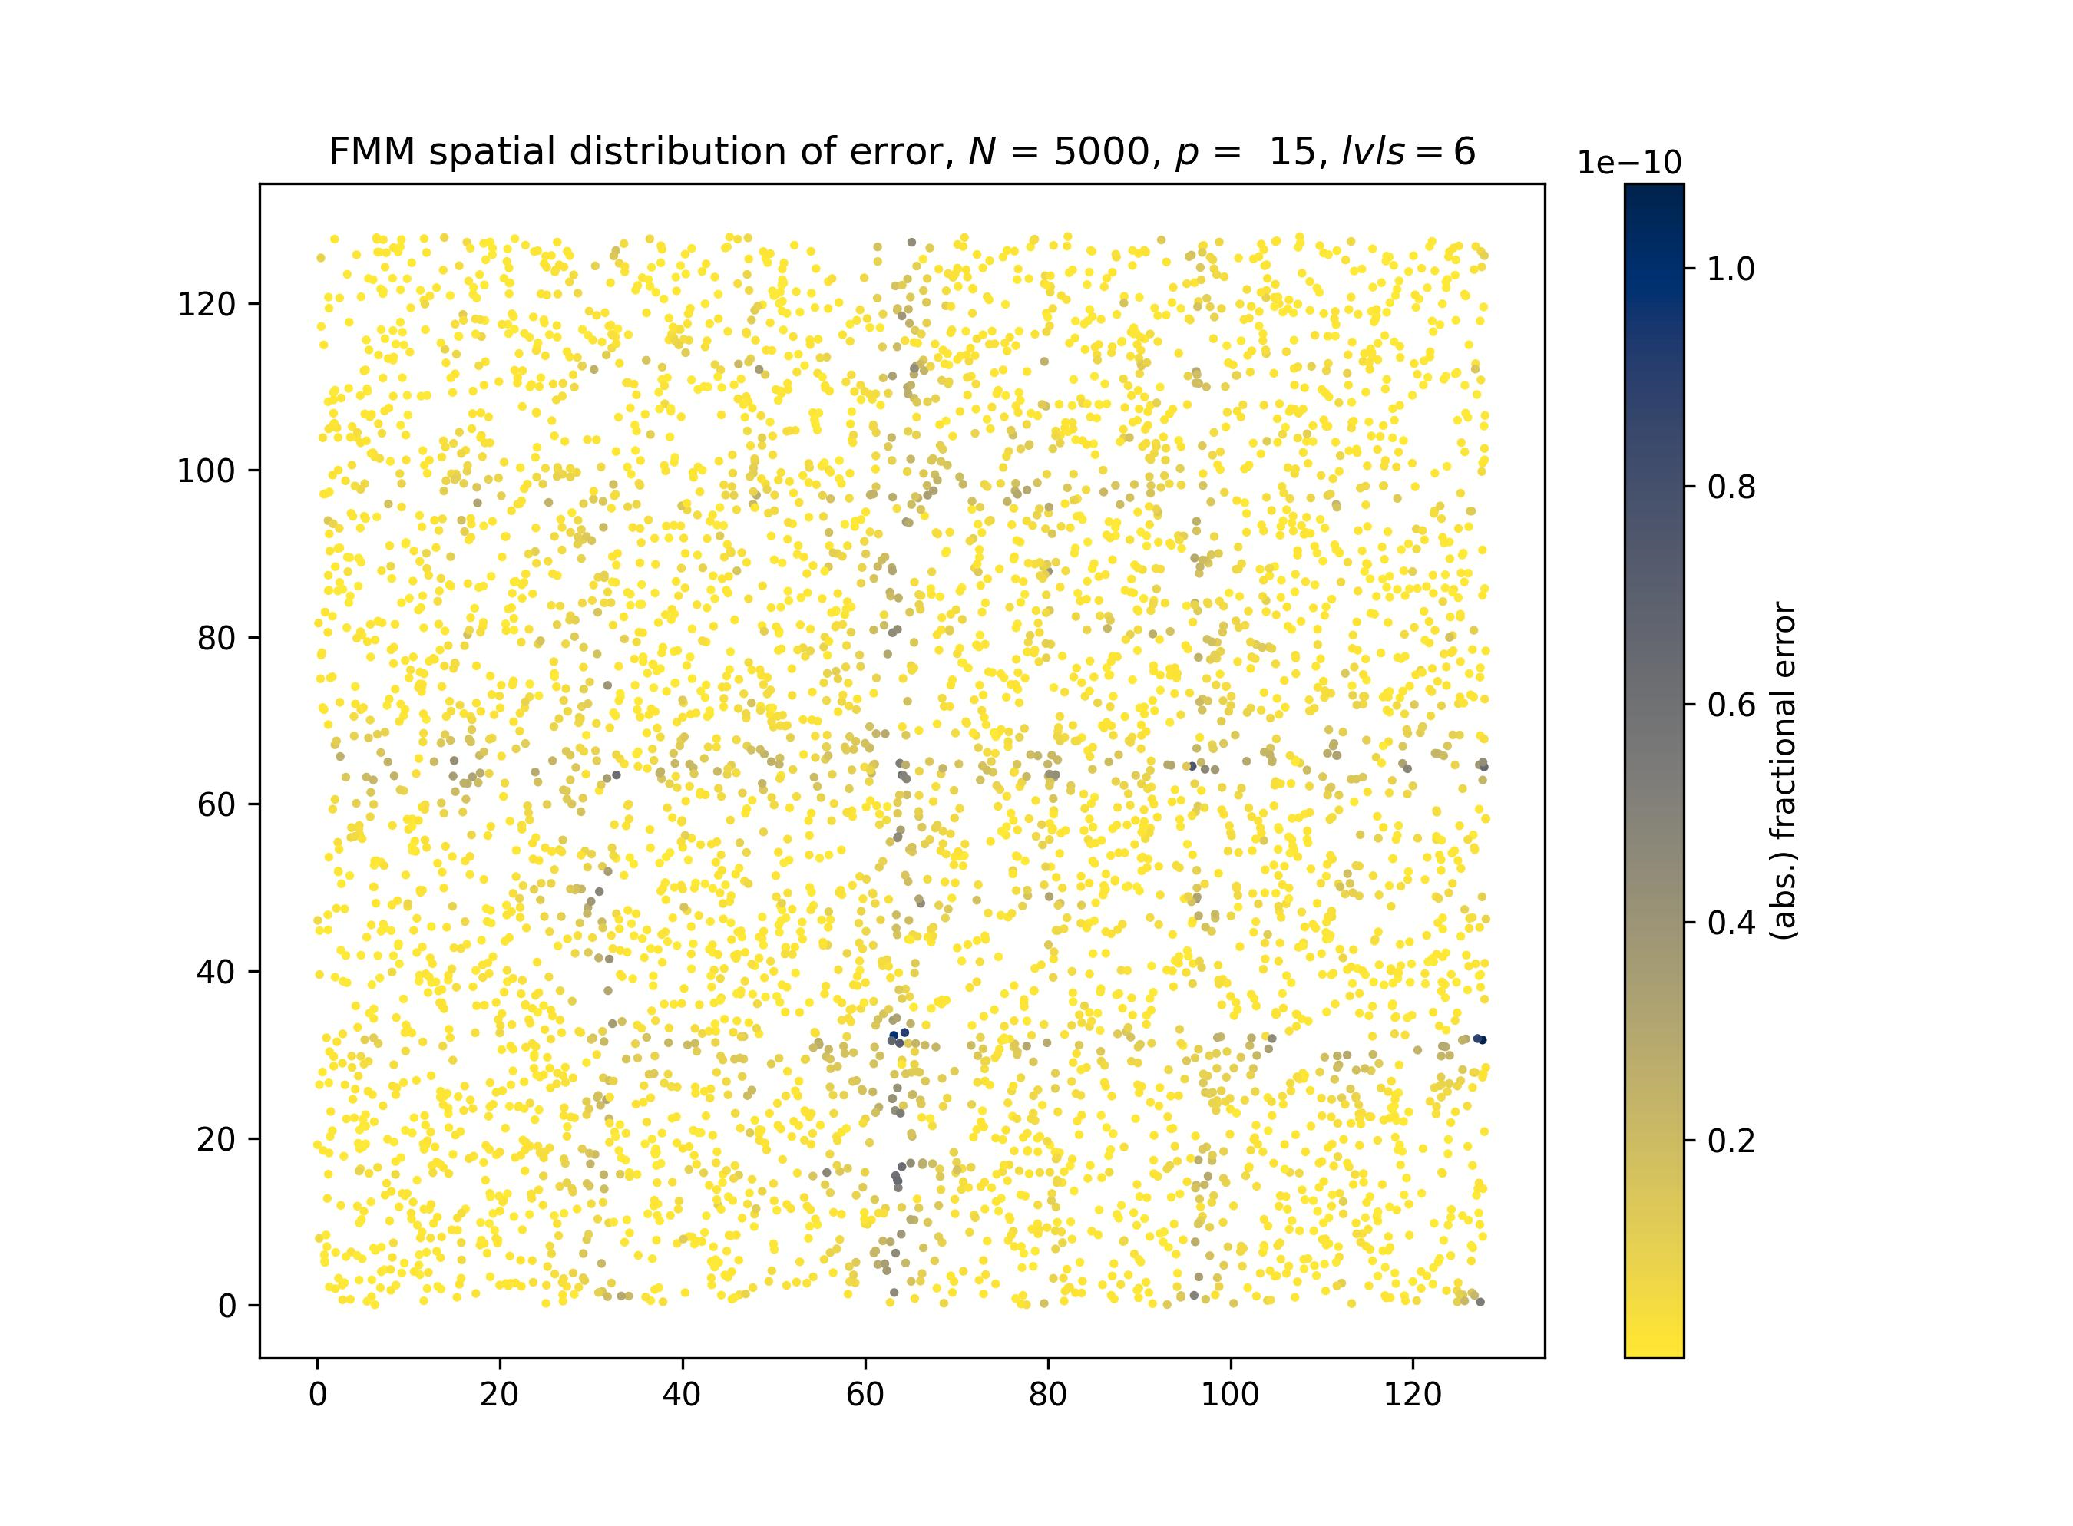
Errors (FMM)
Errors are largest close to the box boundaries
(furthest from expansion centres)

Slide 43
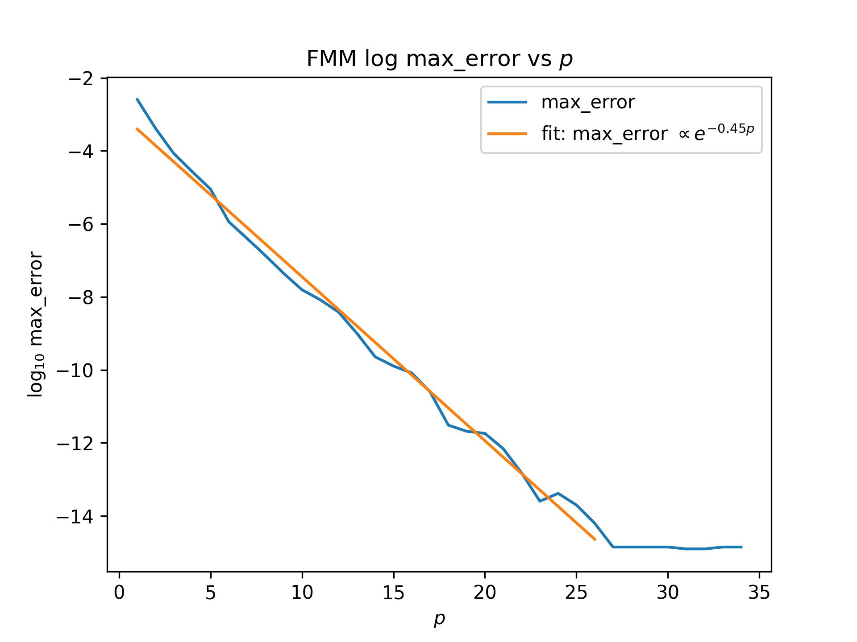
Errors (FMM)
p increases, error decreases
p : order of expansion
machine precision
>>> np.finfo(np.float64)
Out: finfo(resolution=1e-15 …

Slide 44
Improvements/Possible further developments
Calculating the force (straightforward for Barnes-Hut, requires some math for FMM – maybe also AD?)
Adaptive grid for FMM
Improvise M2L step
3D
Different particle distributions

Slide 45
Summary
Both the Barnes-Hut algorithm and the Fast Multipole Method improves the time complexity of N-body problem to below O (N ²)
Barnes-Hut
~O (N logN )
Fast-Multipole Method (FMM)
~O (N )
More precision control

Slide 46
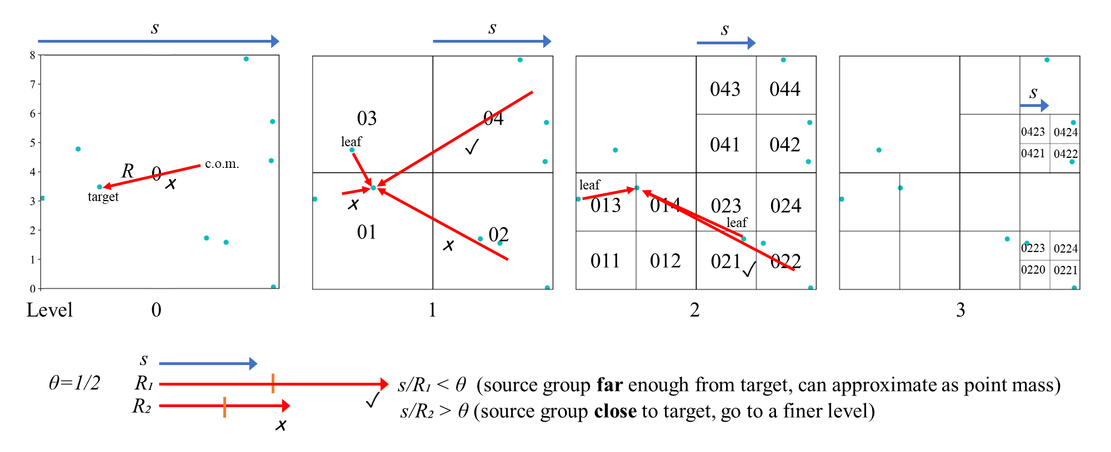
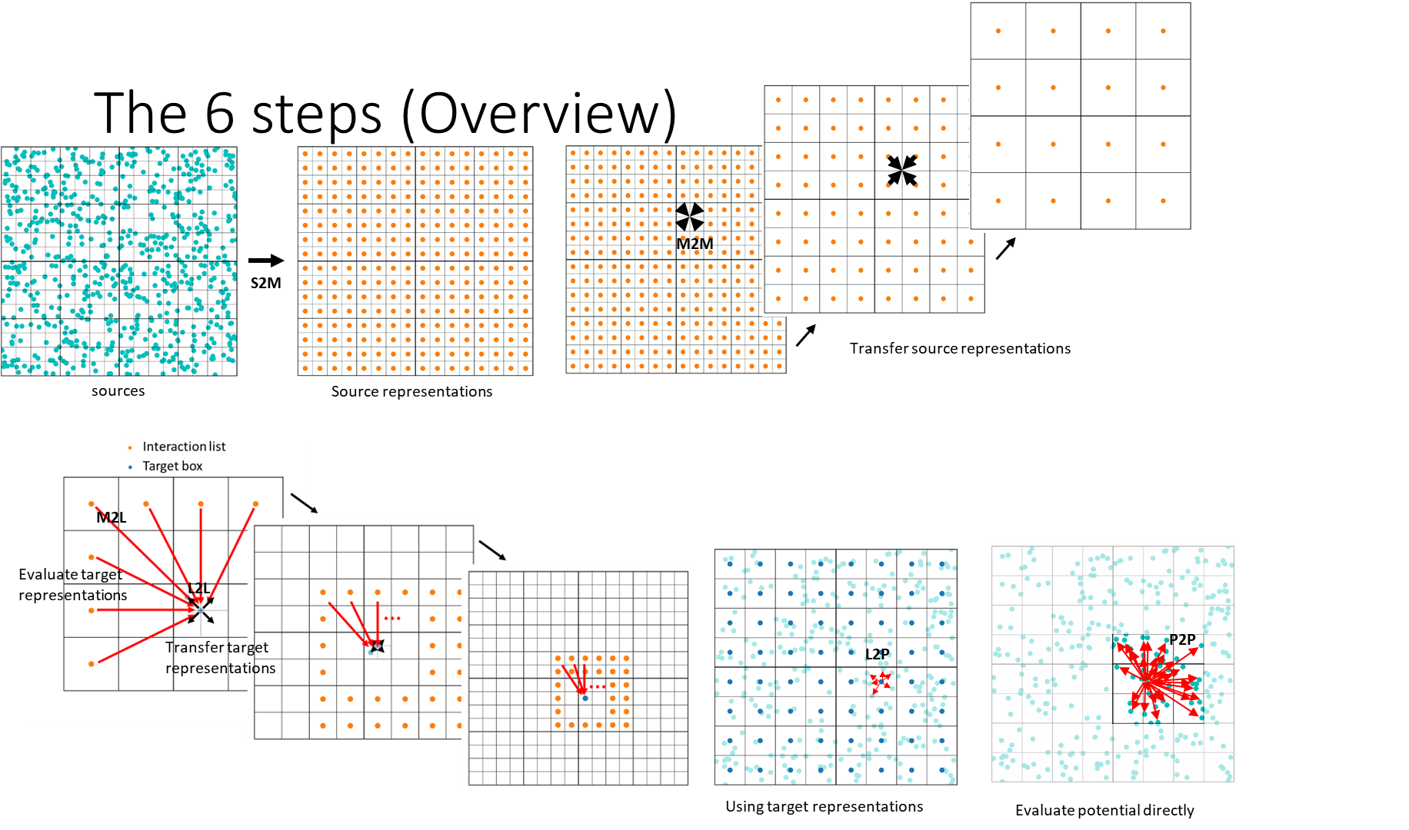
Thank you!
Barnes-Hut Algorithm
Tree + Potential Calc
Timing
Problems
Fast Multipole Method
Tree
6 Steps (Potential Calc)
Timing
Error
References
[1] J. Barnes and P. Hut, “A hierarchical O(N log N) force-calculation algorithm,” , vol. 324, pp. 446–449, Dec. 1986.
[2] L. Greengard and V. Rokhlin, “A fast algorithm for particle simulations,” Journal of Computational Physics, vol. 73, no. 2, pp. 325–348, 1987.
[3] T. Ventimiglia and K. Wayne, “The barnes-hut algorithm,” 2011.
[4] R. Beatson and L. Greengard, “A short course on fast multipole methods,” 1997
Code (Python)
https://github.com/zkeitht/N-Body-Barnes-Hut-FMM/tree/main

